Slide 1
To what extent do salinity and total alkalinity impact growth in juvenile Crassotrea virginica oysters?
Figure 1: comparison of average, 5-week growth at ambient [TA] in ambient versus reduced salinity exposure (34 vs 27)
Figure 2: comparison of average, 5-week growth at ambient S (34) across varying [TA] (reduced, ambient, elevated)

Slide 2
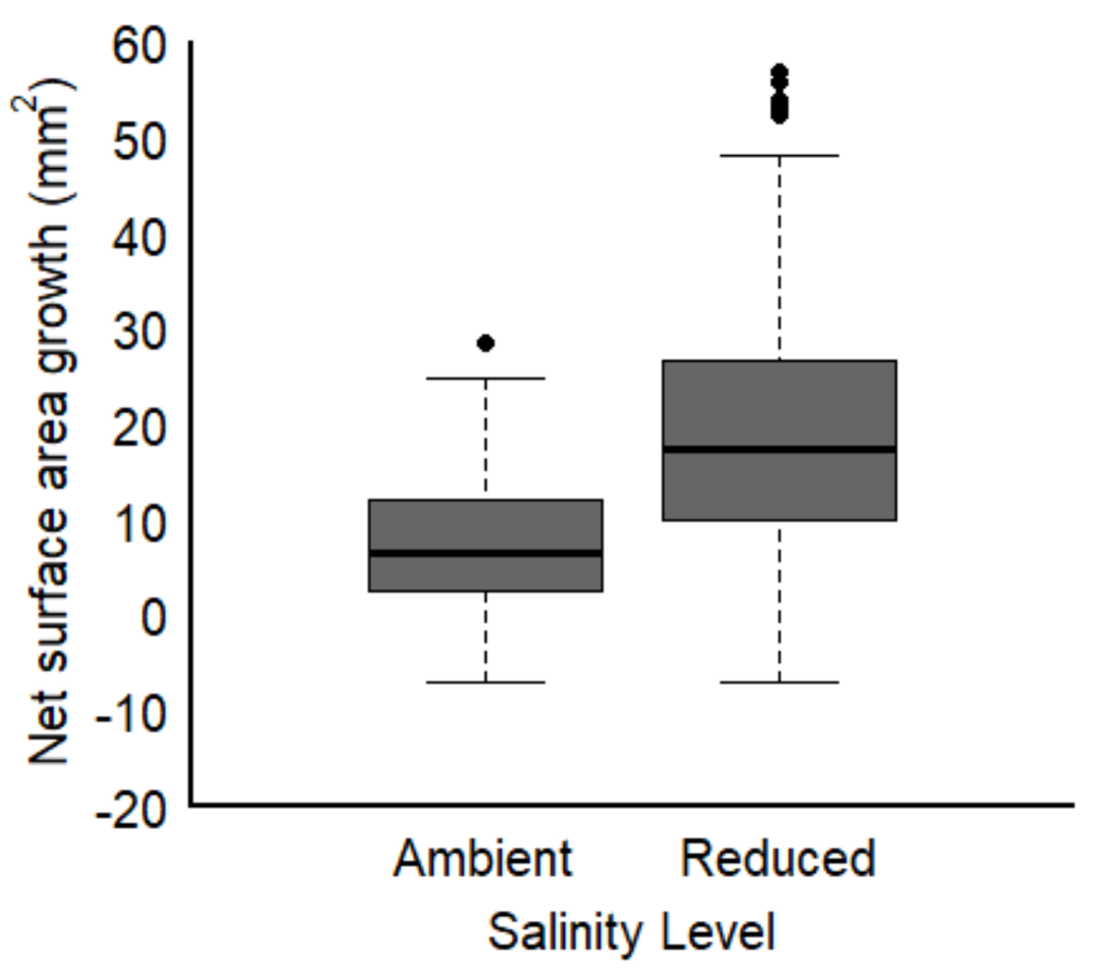
Oysters exposed to reduced salinity conditions had higher net growth rates than those exposed to ambient salinity
Figure 1: comparison of average, 5-week growth at ambient [TA] in ambient versus reduced salinity exposure (34 vs 27)

Slide 3
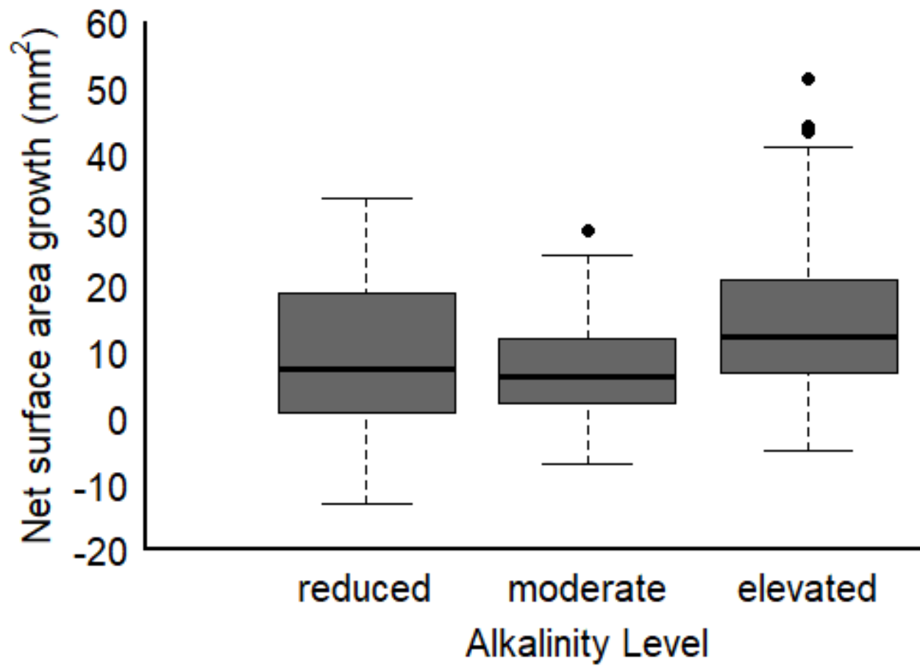
Oysters exposed to elevated alkalinity had higher net growth than those in ambient and reduced alkalinity treatments.
Figure 2: comparison of average, 5-week growth at ambient S (34) across varying [TA] (reduced, ambient, elevated)

Slide 4
To what extent does the total alkalinity of the freshwater source impact growth of juvenile Crassotrea virginica oysters exposed to low salinity conditions?
Figure 3: comparison of average, 5-week growth in conditions when reduced salinity is simulated as: (i) rainfall, (ii) low TA freshwater source, (iii) high TA freshwater source

Slide 5
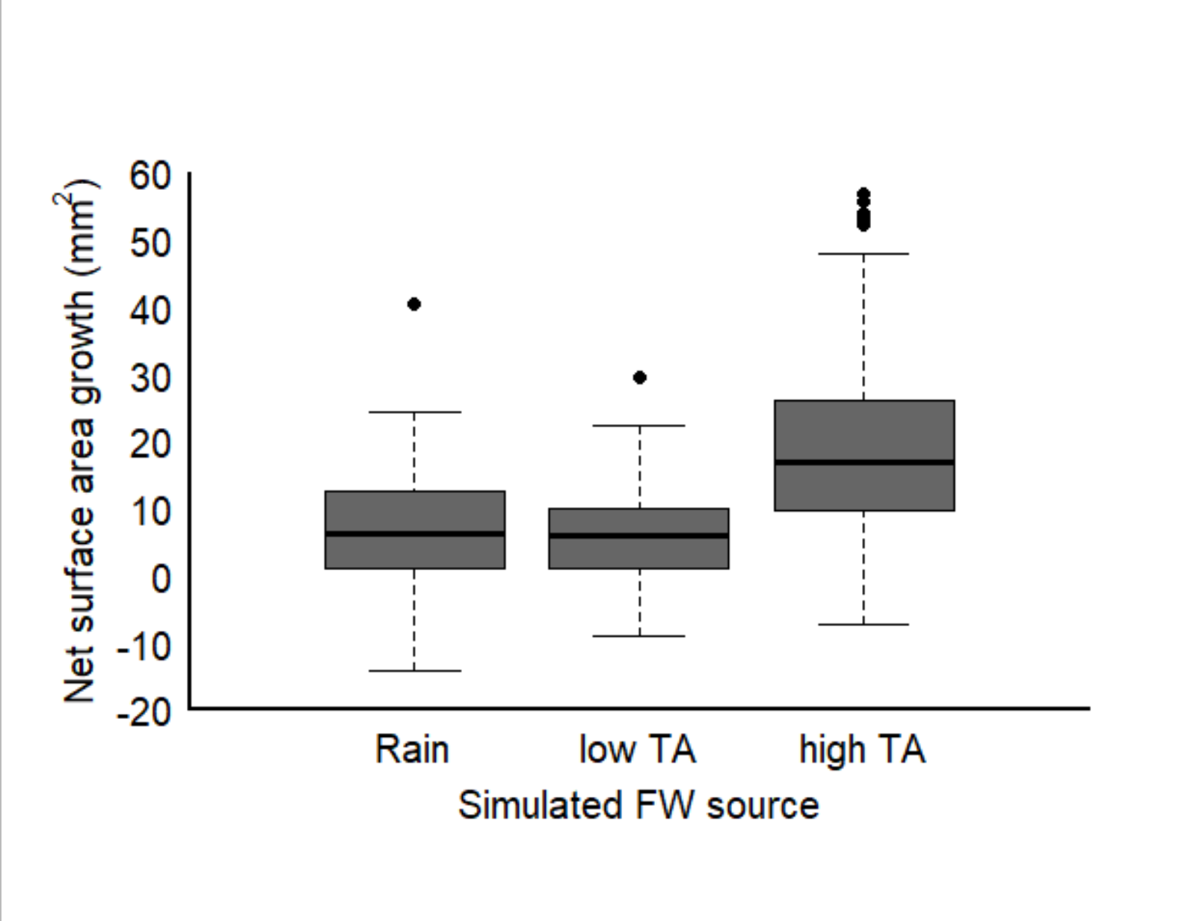
We did not detect a difference in net growth between oysters exposed to treatments diluted with DI and those exposed to conditions imitating exposure to freshwater with low alkalinity signature. However, net growth was higher in conditions simulating exposure to freshwater with elevated alkalinity
Figure 3: comparison of average, 5-week growth in conditions when reduced salinity is simulated as: (i) rainfall, (ii) low TA freshwater source, (iii) high TA freshwater source

Slide 6
Do we detect ‘shock’ growth responses in juvenile Crassotrea virginica oysters?
Figure 4: comparison of incremental growth rates (mm2/day) from the first two weeks of exposure and the last three weeks of exposure along a gradient of [TA] in ambient salinity
Figure 5: comparison of incremental growth rates (mm2/day) from the first two weeks of exposure and the last three weeks of exposure to salinity reduced by three hypothetical scenarios (rainfall, low TA stream, high TA stream)

Slide 7
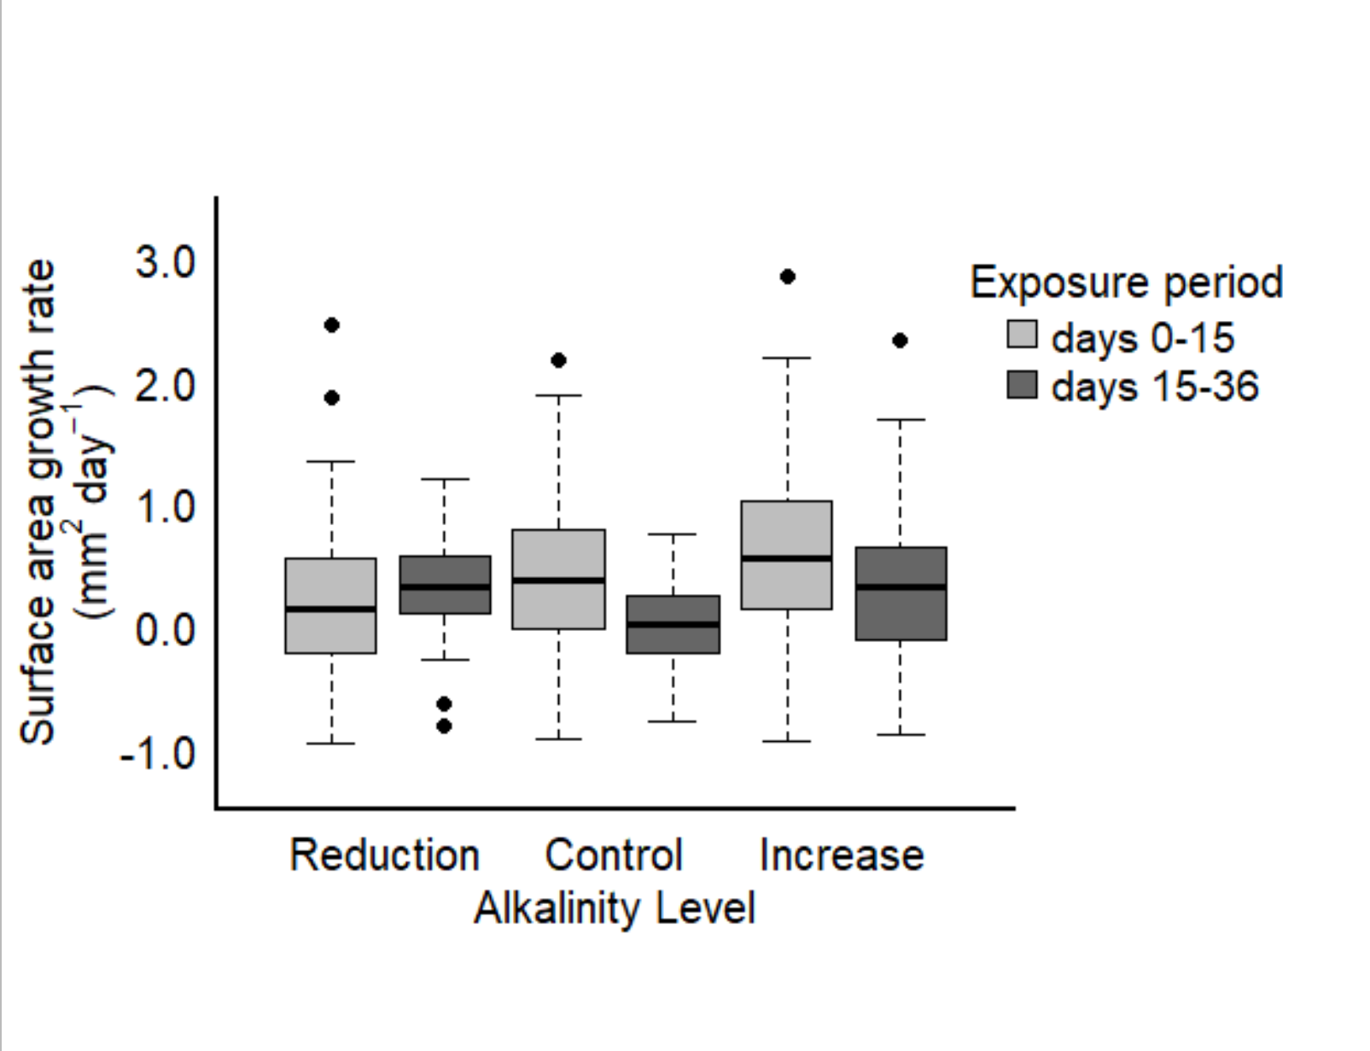
Oyster growth rates had a positive relationship with [TA] over the first two weeks.
Only in treatments with reduced [TA] did we see an increase in incremental growth after two weeks.
Incremental growth slowed down in ambient and elevated TA conditions beyond two weeks of exposure
Figure 4: comparison of incremental growth rates (mm2/day) from the first two weeks of exposure and the last three weeks of exposure along a gradient of [TA] in ambient salinity

Slide 8
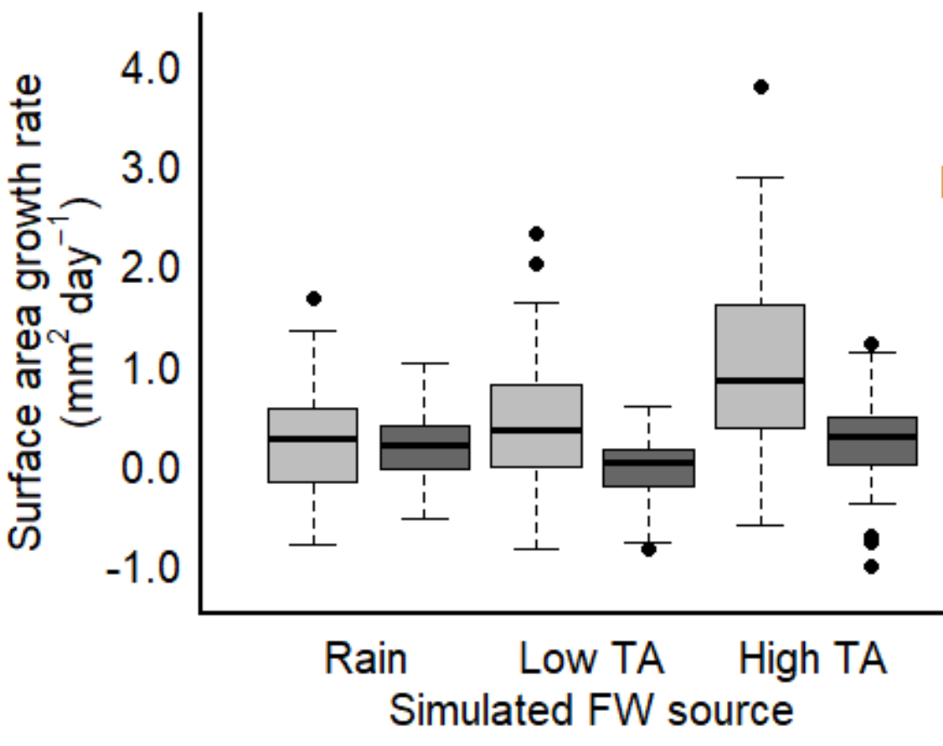
There is a strong effect of high TA on incremental growth rate within the first two weeks.
This effect is persistent, thus, not a ‘shock effect’, however, it does appear to weaken through time
Thus, the added effect of increased alkalinity under low salinity conditions may be most beneficial for immediately upon exposure to low S conditions.
Figure 5: comparison of incremental growth rates (mm2/day) from the first two weeks of exposure and the last three weeks of exposure to salinity reduced by three hypothetical scenarios (rainfall, low TA stream, high TA stream)

Slide 9
To what extent do modified S and TA impact overall C allocation?
Figure 6: comparison of the organic content found in the shell and CI between high and low salinities (at ambient [TA])
Figure 7: comparison of the organic content found in the shell and CI along a gradient of [TA] at ambient salinity
Figure 8: comparison of the organic content found in the shell and CI along a gradient of simulated FW exposure levels

Slide 10
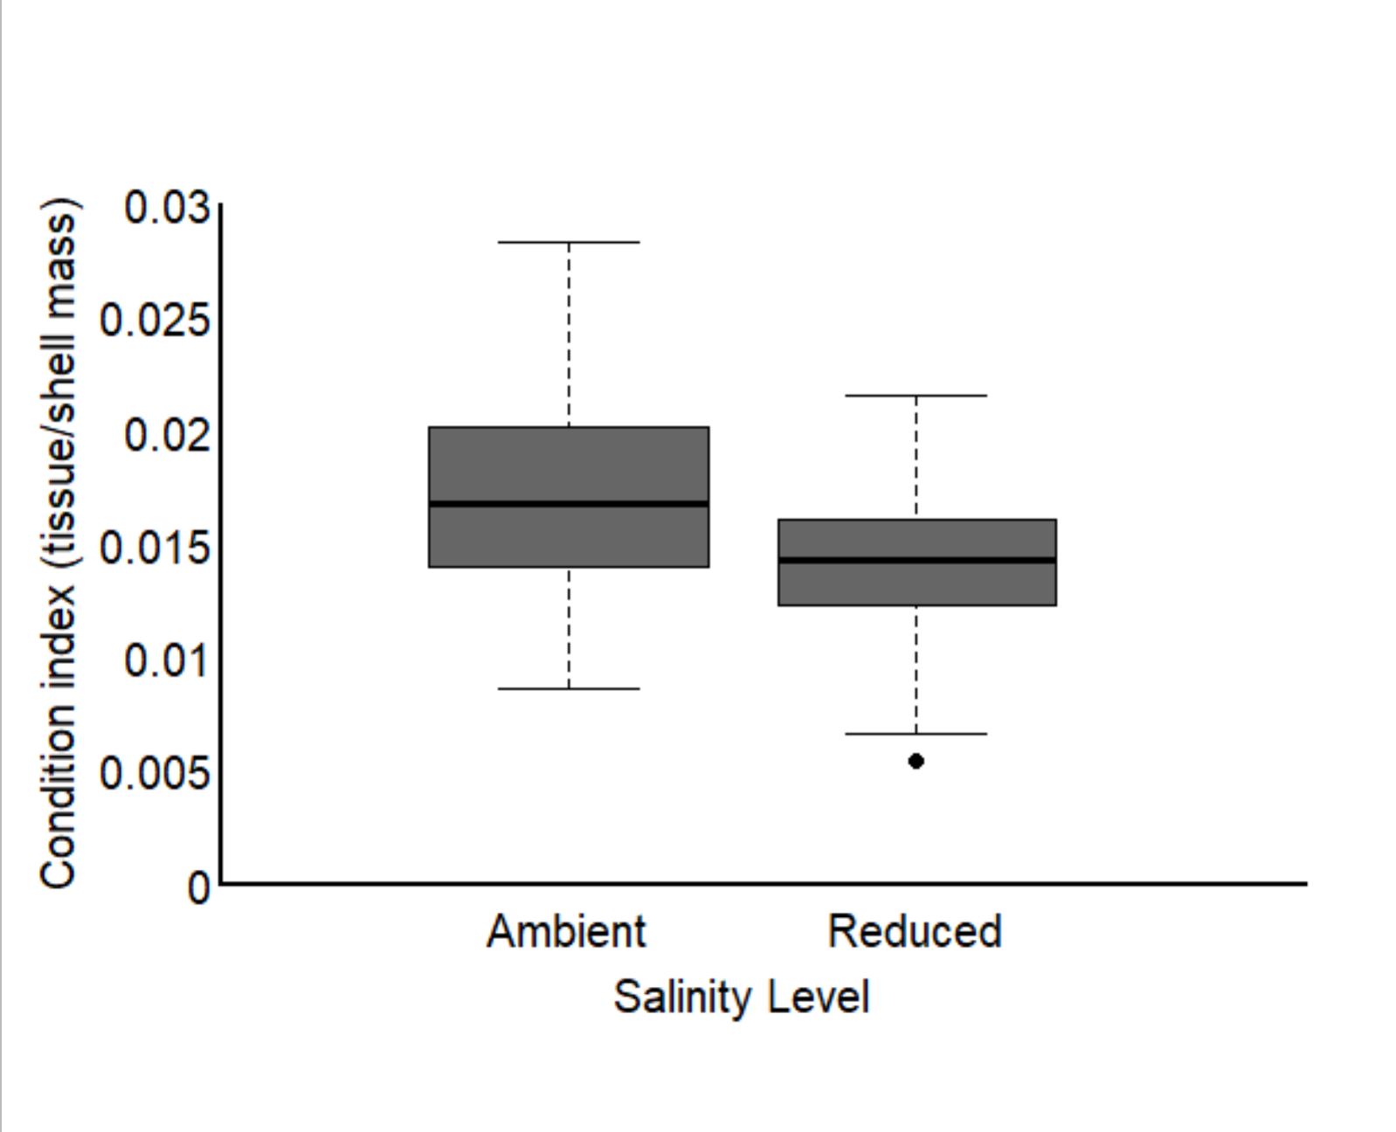
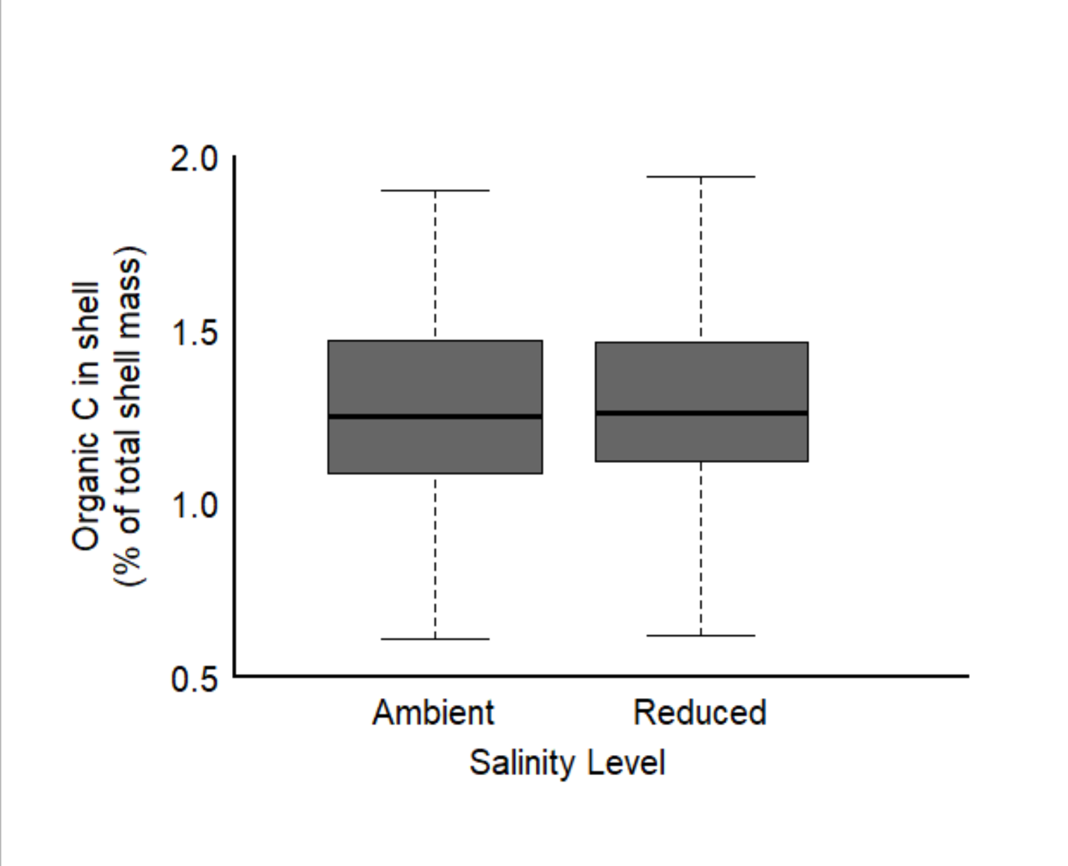
Low salinity did not influence % OC in shell, but did reduce condition index
Figure 6: comparison of the organic content found in the shell and CI between high and low salinities (at ambient [TA])

Slide 11
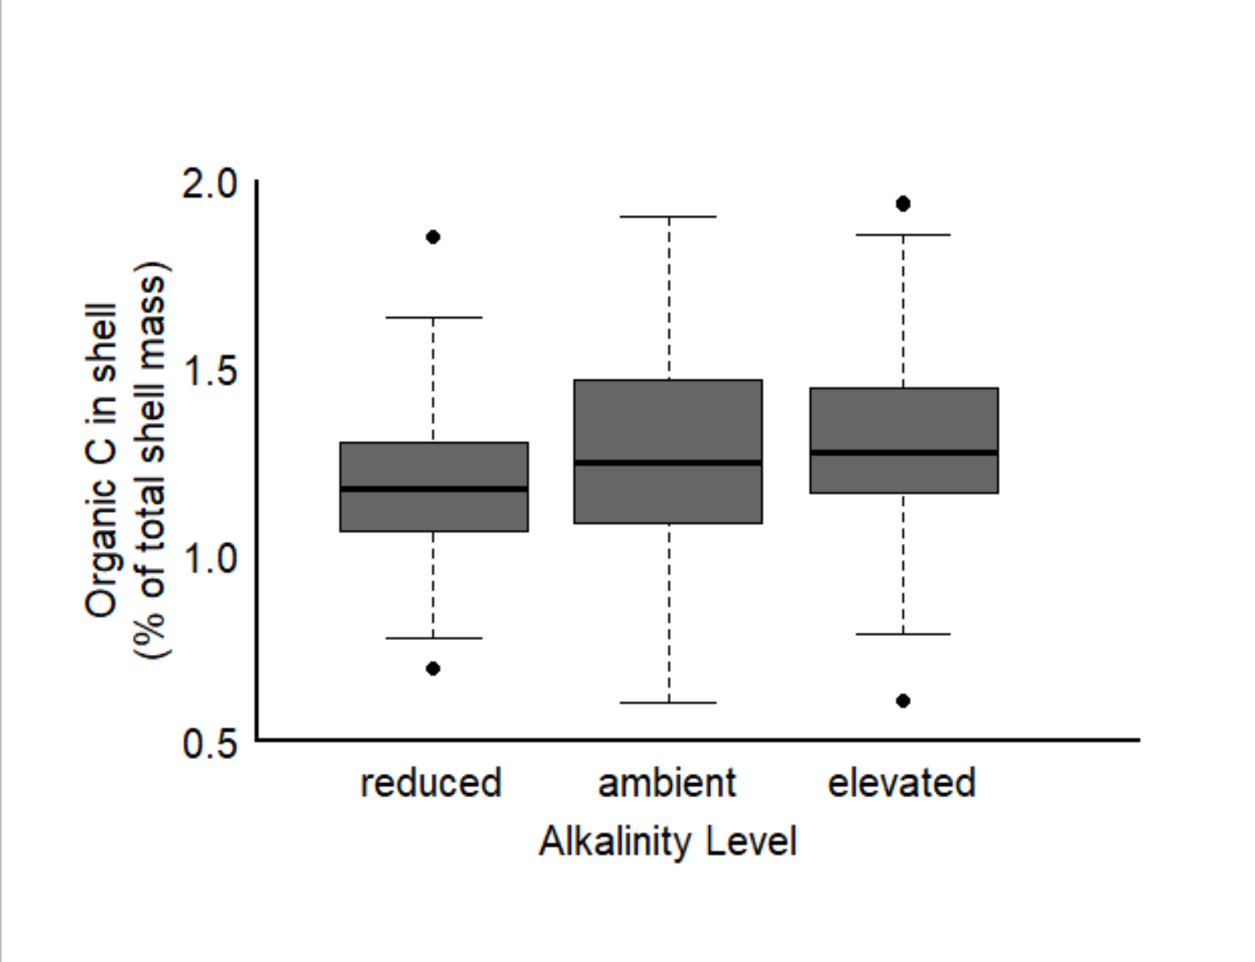
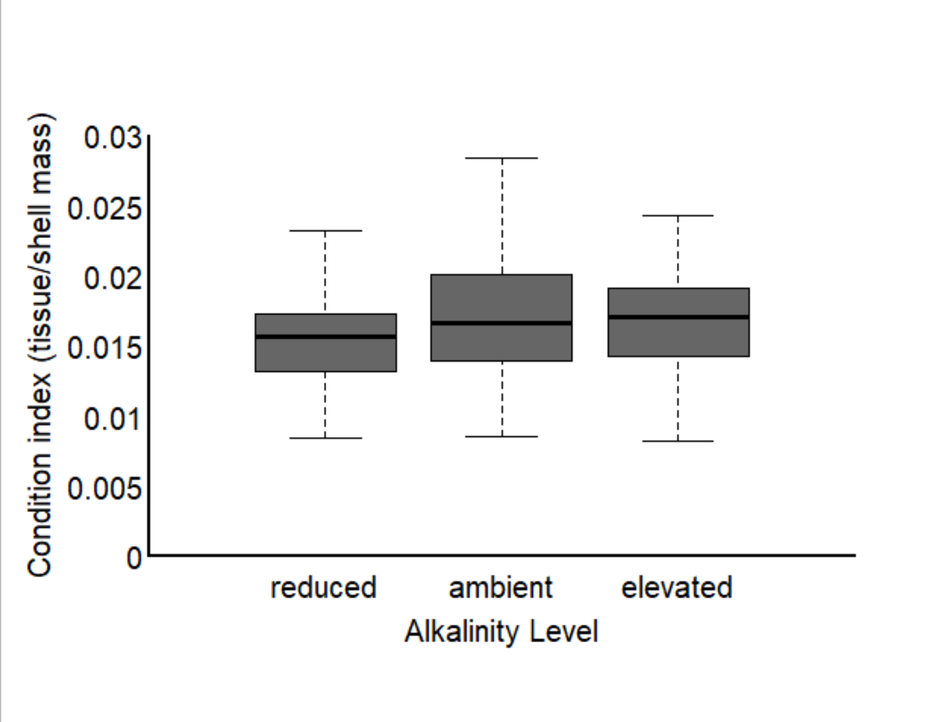
[TA] impacted % OC in shell and condition index similarly
Figure 7: comparison of the organic content found in the shell and CI along a gradient of [TA] at ambient salinity

Slide 12
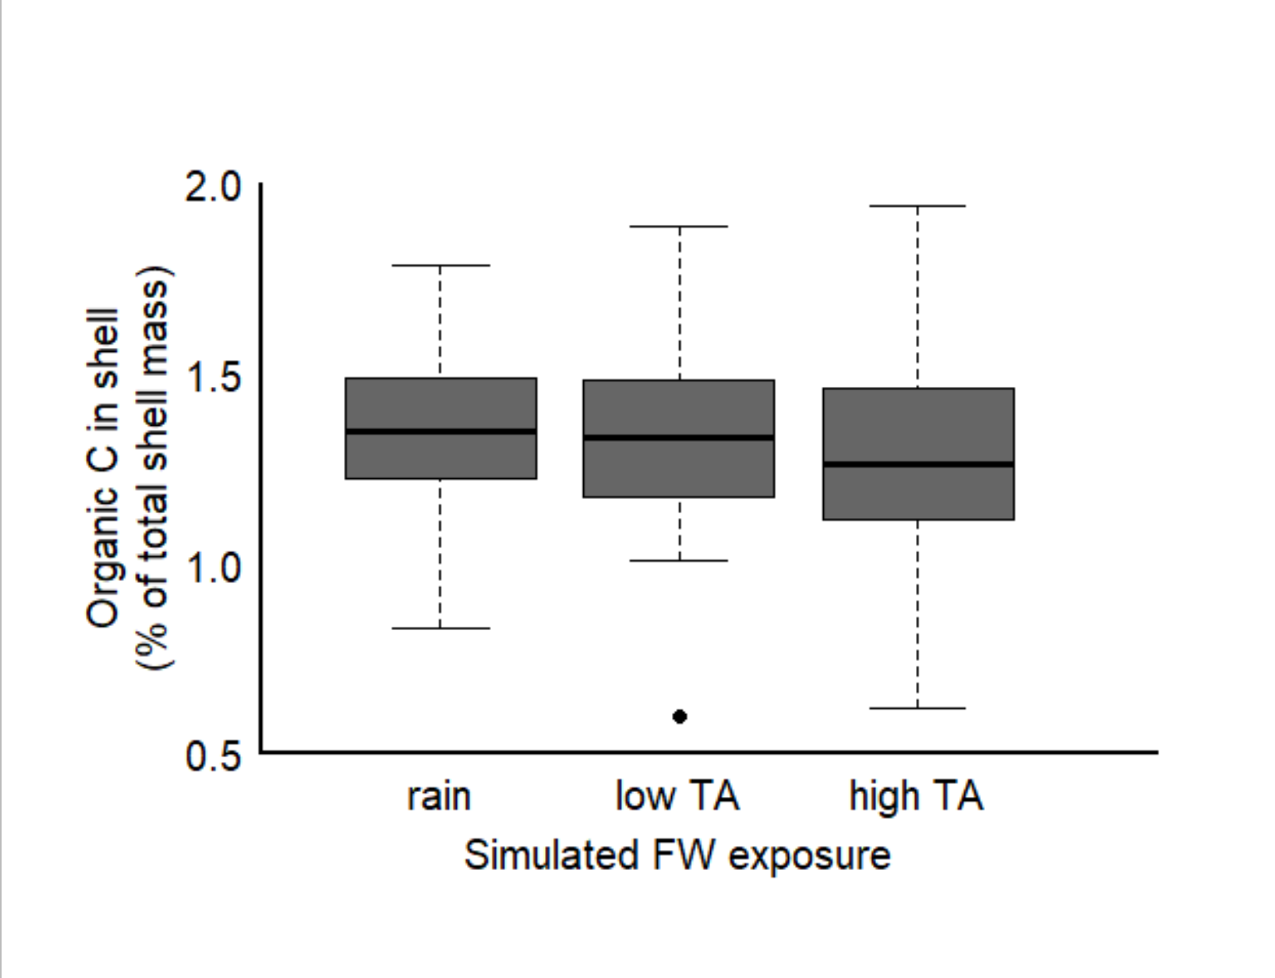
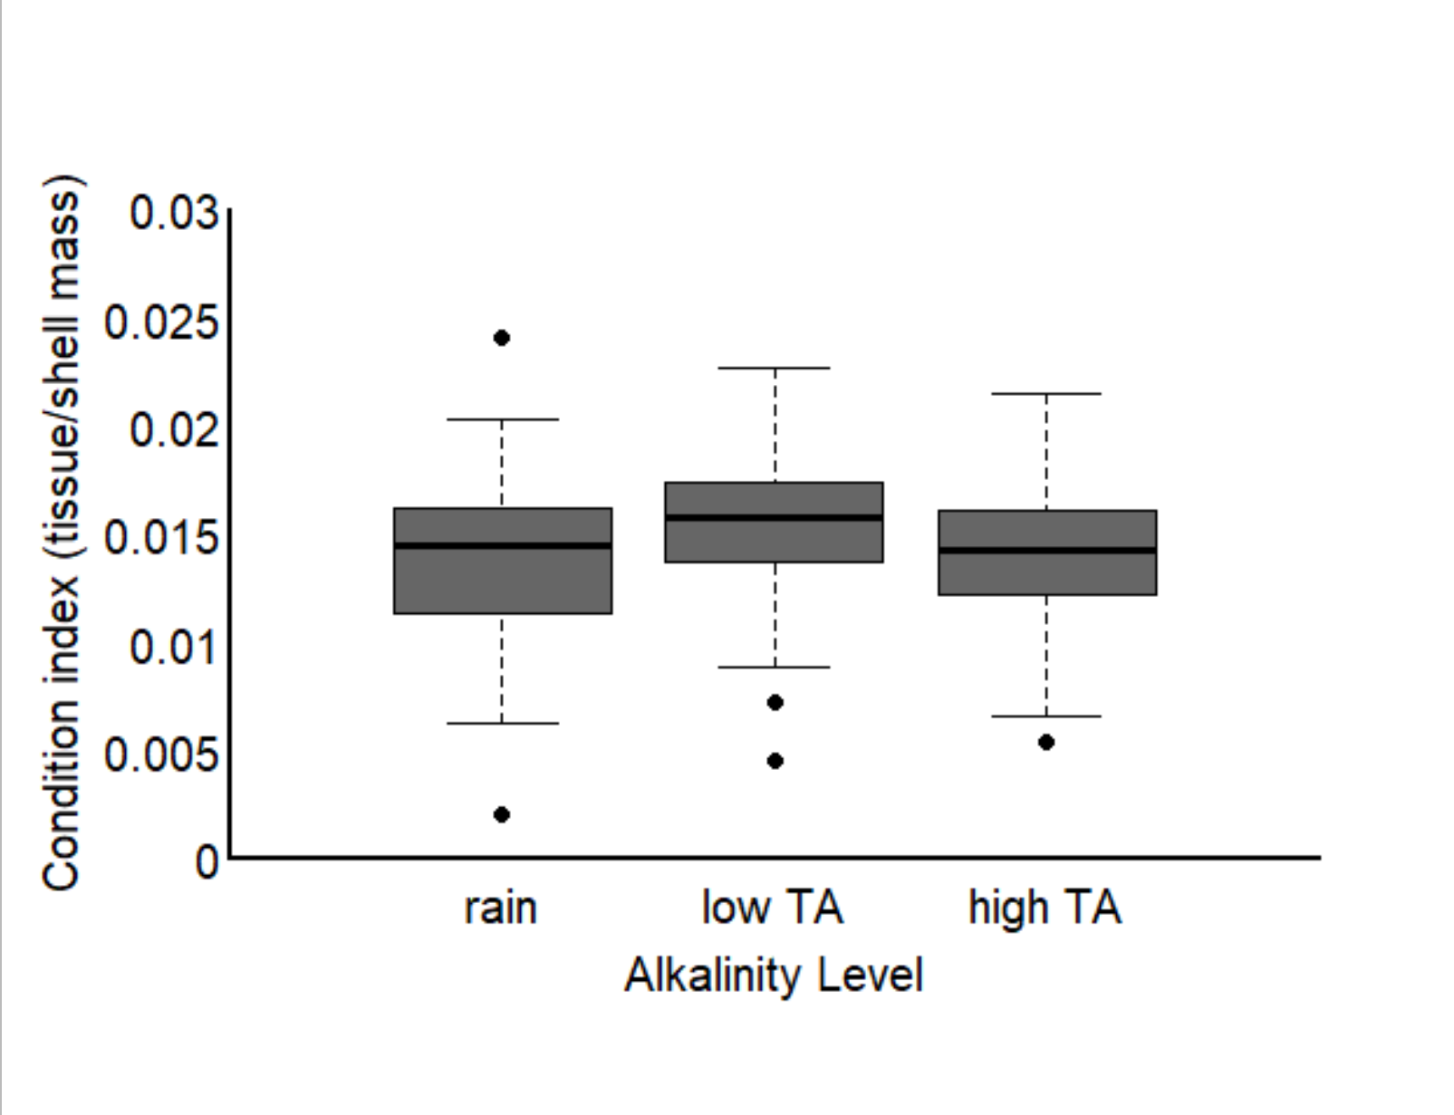
Altered [TA] did not impact %OC in shell, however, condition index was lowest in the rain and high [TA] simulation
Figure 8: comparison of the organic content found in the shell and CI along a gradient of simulated FW exposure levels

Slide 13
What can we say when we put it all together?
Oyster growth was higher in low salinity conditions in amb [TA] (Fig 1)
Oysters also had lower CI values in low salinity conditions; however %OC did not differ (Fig 6)
Oyster growth is elevated by increased total alkalinity above ambient seawater concentrations (Fig 2)
Which was largely driven by high incremental growth in the first two weeks, with incremental growth declining between week 2-5 in the ambient and high TA conditions…(Fig 5)
Ambient and elevated TA had similar CI and %OC in the shell, higher than low TA (Fig 7)
Oyster growth is maintained when alkalinity is severely reduced below ambient conditions (60% reduction) in ambient salinity(Fig 2)
Which was largely driven by an increase in incremental growth after 2 weeks exposure to low TA conditions (Fig 5)
Low TA exposure reduced the %OC and CI of oysters (Fig 7)
Oysters exposed to freshwater inputs that have elevated [TA], have higher growth than those exposed to rainfall/low TA rivers (Fig3)
Which was largely driven by increased incremental growth in the first two weeks, with incremental growth declining between week 2-5…(Fig 5)
We see no difference in %OC in the shell across the freshwater treatments (fig 8)
Individuals from rain exposure and elevated FW TA had lower CI values (Fig 8); this matches the pattern of incremental growth at the later time point (Fig 5)

Slide 14
Let’s also look at variability?

Slide 15
Oysters exposed to reduced salinity conditions had higher variability in growth response
Figure 1: comparison of average, 5-week growth at ambient [TA] in ambient versus reduced salinity exposure (34 vs 27)

Slide 16
Alkalinity concentration did not change the variability in growth.
Figure 2: comparison of average, 5-week growth at ambient S (34) across varying [TA] (reduced, ambient, elevated)

Slide 17
High TA FW exposure had higher variability than in rain and low TA exposure
Figure 3: comparison of average, 5-week growth in conditions when reduced salinity is simulated as: (i) rainfall, (ii) low TA freshwater source, (iii) high TA freshwater source

Slide 18
Variability declined in all treatments through time
Figure 4: comparison of incremental growth rates (mm2/day) from the first two weeks of exposure and the last three weeks of exposure along a gradient of [TA] in ambient salinity

Slide 19
Variability declined in all treatments through time
Figure 5: comparison of incremental growth rates (mm2/day) from the first two weeks of exposure and the last three weeks of exposure to salinity reduced by three hypothetical scenarios (rainfall, low TA stream, high TA stream)

Slide 20
Similar variability
Figure 6: comparison of the organic content found in the shell and CI between high and low salinities (at ambient [TA])

Slide 21
Ambient [TA] showed the highest level of variation
Figure 7: comparison of the organic content found in the shell and CI along a gradient of [TA] at ambient salinity

Slide 22
A large range in Organic C measurements, whereas variation in CI was similar
Figure 8: comparison of the organic content found in the shell and CI along a gradient of simulated FW exposure levels

Slide 23
Ch 3 thoughts…

Slide 24
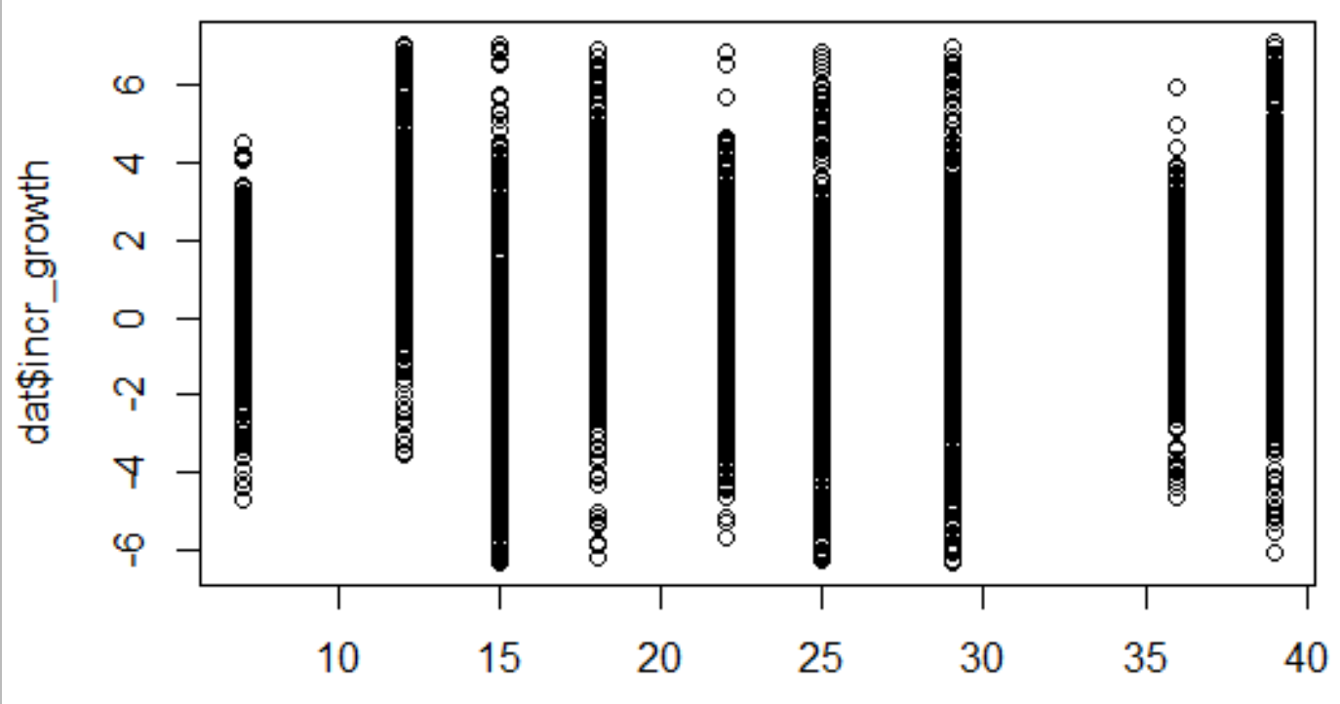
In both salinities, incremental growth cycled

Slide 25
Now just isolate week 1, 2, and the last week

Slide 26
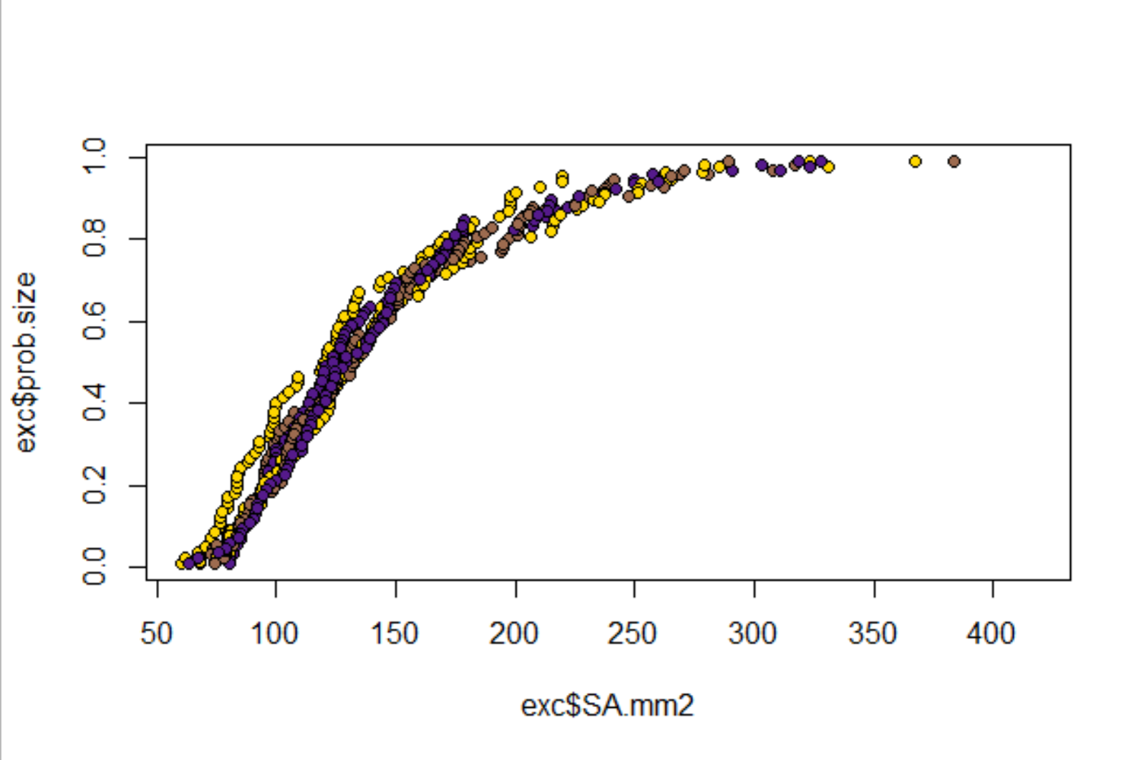
Nice to verify: All the oysters starting surface area rankings and probability of exceedance curves were are similar. Yay!
Low TA
Mod TA
High TA
Probability of exceedance
Starting time point
Surface area of shell (mm2)

Slide 27
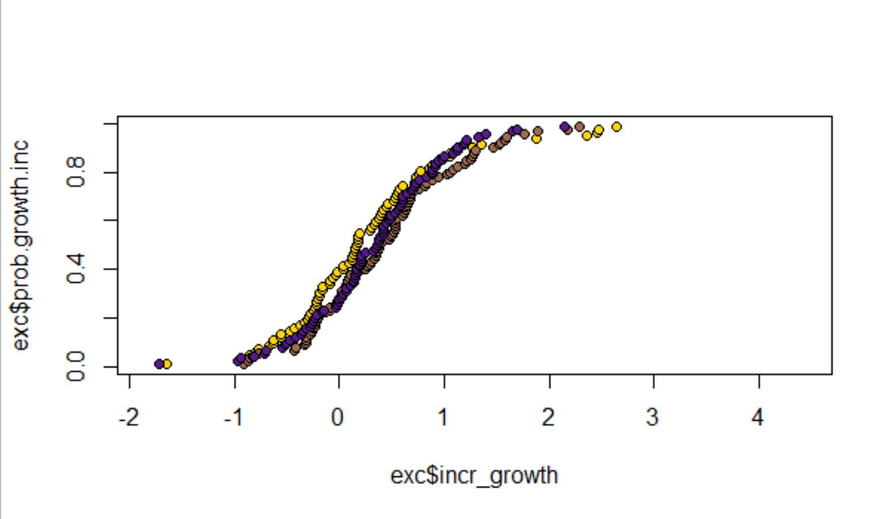
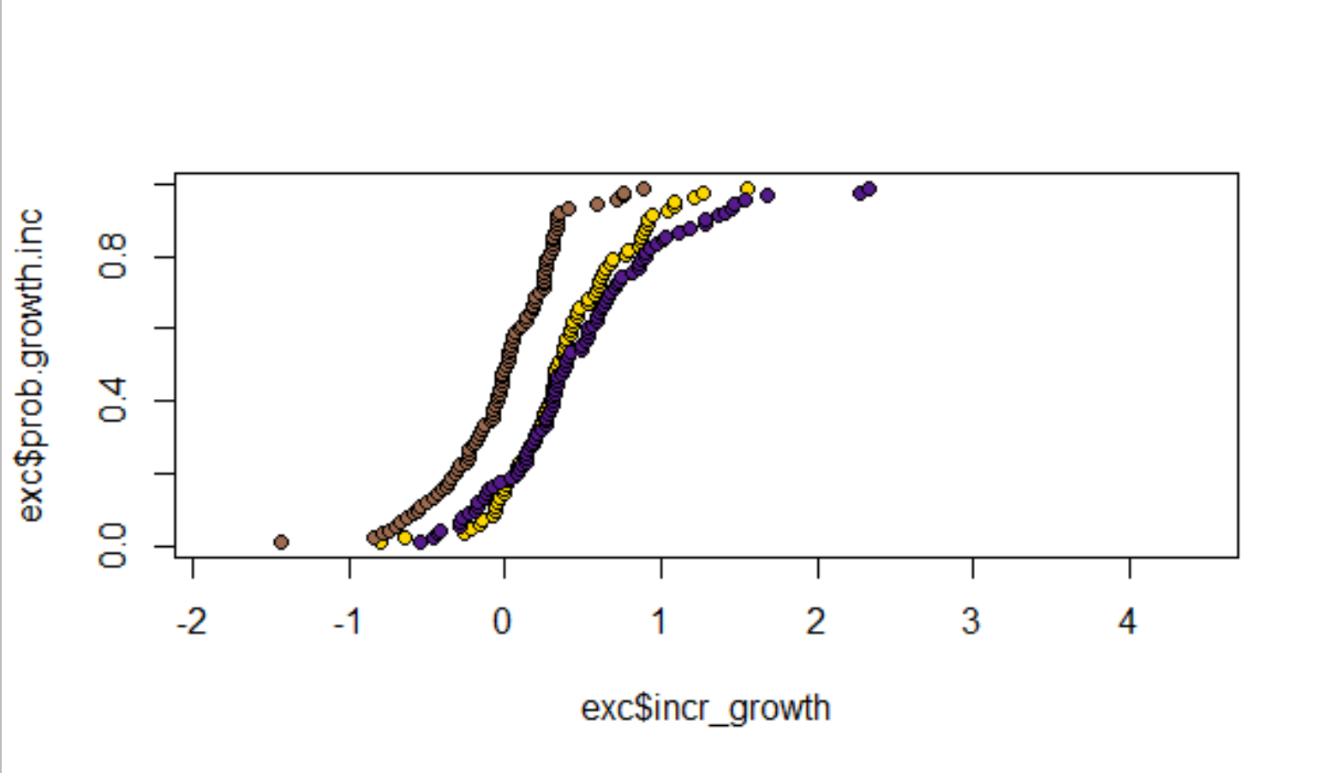
Oysters in ambient salinity: Total alkalinity changes did not influence incremental growth rate (mm2/day calculated between t=0 & t=2 and t=2 & t=5) by week 2 of exposure. Q: How do oysters in ambient salinity maintain incremental growth for the first two weeks of exposure across TA level? Food availability providing a way to upregulate metabolic CO2 pathway for calcification? Between week 2 and week 5, however, it looks like individuals exposed to elevated TA and severely reduced TA had the largest incremental growth rates. Q: reason for severe decline and elevation in TA to result in higher incremental growth rate? What about a moderate TA reduction drives a decrease in incremental growth? Q: what physiologically happens after two weeks that demonstrates a stronger response of TA on incremental growth rate?
Total alkalinity level (umol/kg; % change from ambient)
Low (860; -60%)
Mod (1860; -15%)
High (2840; + 25%)
Week 0-2
Probability of exceedance
Week 2-5
Incremental growth rate (ave mm2/day)

Slide 28
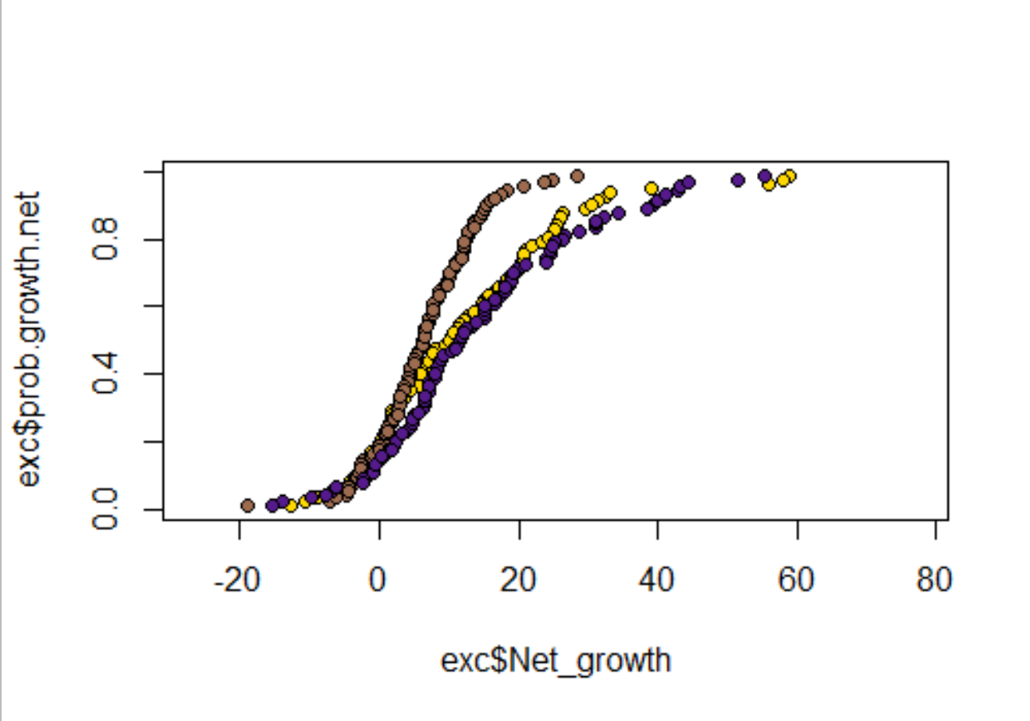
Oysters in ambient salinity: Net growth was elevated in both increased TA and high reduction exposures over 5 weeks, relative to moderate reductions from ambient conditions. It appears that the largest impact on the net effect occurred between week 2 and week 5, where individual incremental growth had a similar pattern to the net growth. This suggests that organismal performance in response to carbonate chemistry changes may not arise until after 14 full days of acclimation to the conditions? However, the elevated growth in low TA conditions is interesting. Do we think that they are upregulating their metabolic inputs from carbonate stress and because they were well fed, were able to compensate for any loss attributed to abiotic conditions. But then what about the modest reduction in TA and its weaker impact on net growth. Is it a reduction in TA that is not enough of a “low shock” to start to upregulate food consumption? Therefor, the reduction may result in an increased proportion of shell that is abiotically eroded and uncompensated for with food?
Total alkalinity level (umol/kg; % change from ambient)
Probability of exceedance
Low (860; -60%)
Mod (1860; -15%)
High (2840; + 25%)
Week 0-5
Net growth (mm2)
Notes:
Things to note: the SA to shell wt relationship did not differ between TA or S trials.

Slide 29
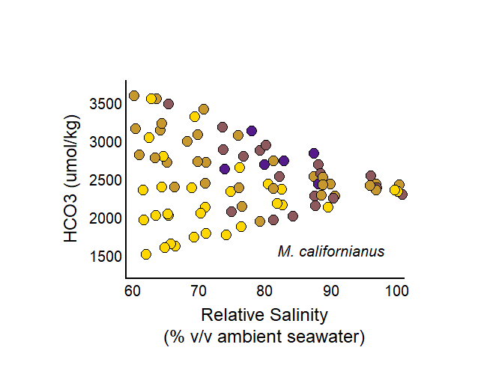
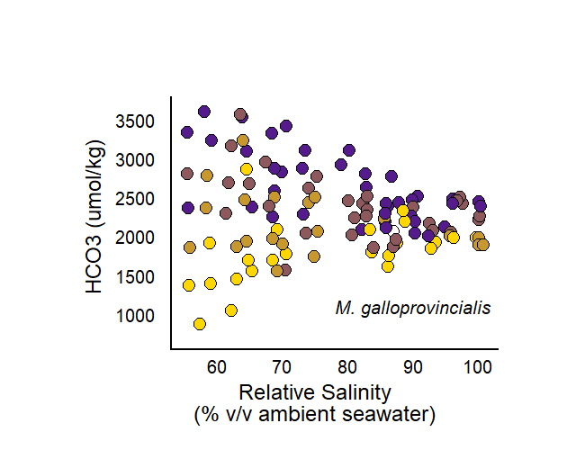
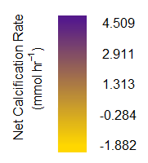
Comparison to ch 2 results for mussels
In mussels…we see that regardless of S, net calc increases with increasing TA… and that effect weakens as you reduce salinity.
However, in oysters, we see that at high S, over the short term (0-2 weeks), that alkalinity did not have an effect on shell growth.
We see the effect of changed alkalinity by the end of the exposure, where it has a bimodal relationship with net growth.

Slide 30
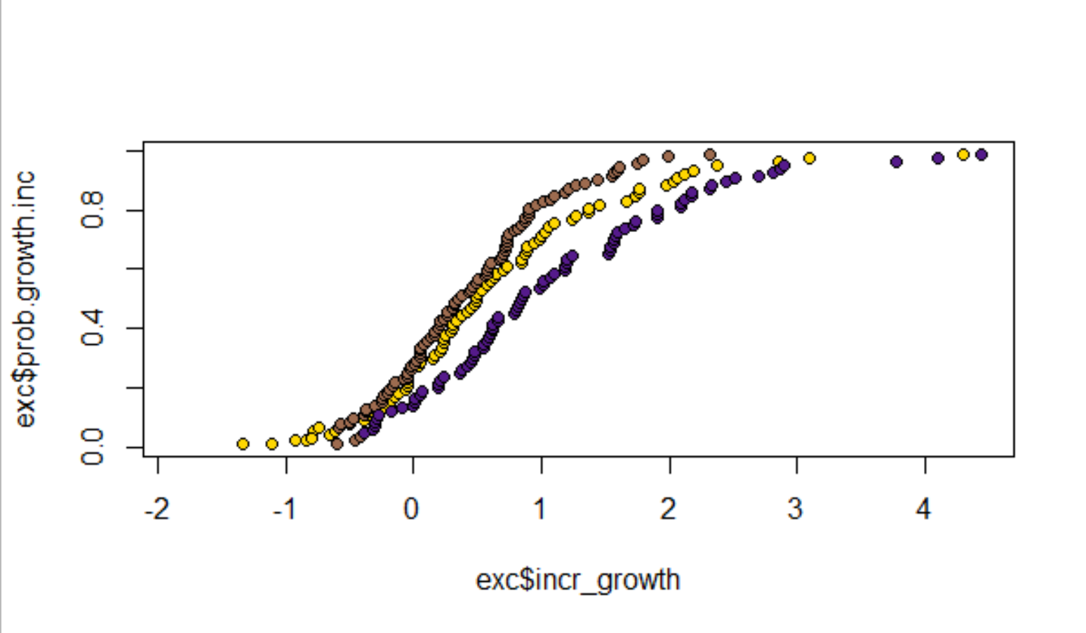
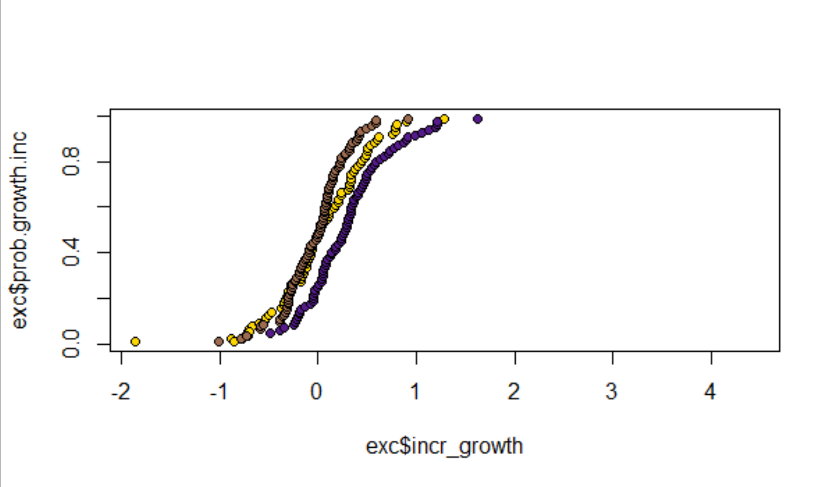
Oysters in low salinity: A reduction in total alkalinity did result in a decrease in incremental growth (mm2/day calculated between t=0 & t=2 and t=2 & t=5) within the first two weeks of exposure. Relative to the highest TA treatment (similar to ambient sw), individuals exposed to an extreme reduction had higher incremental growth than those in moderate reductions of TA. Q: how do individuals make up for the lack of HCO3- present in the seawater more so for the extreme reduction in TA? What about a moderate TA reduction drives a decrease in incremental growth? Between week 2 and week 5, however, it looks like the effect of low TA doesn’t really seem to impact incremental growth rates (it is similar to high TA rates). Q: Why do we see declines in incremental growth rate overall for low salinity exposed individuals after 5 weeks? Are these size related declines (larger individuals grow more slowly?) Q: Why do we tend to only see the effects of low TA on incremental growth rate in the beginning of the exposure?
Week 0-2
Probability of exceedance
Total alkalinity level (umol/kg; % change from ambient)
Low (650; -70%)
Mod (1415; -35%)
High (2130; < -5%)
Week 2-5
Incremental growth rate (ave mm2/day)

Slide 31
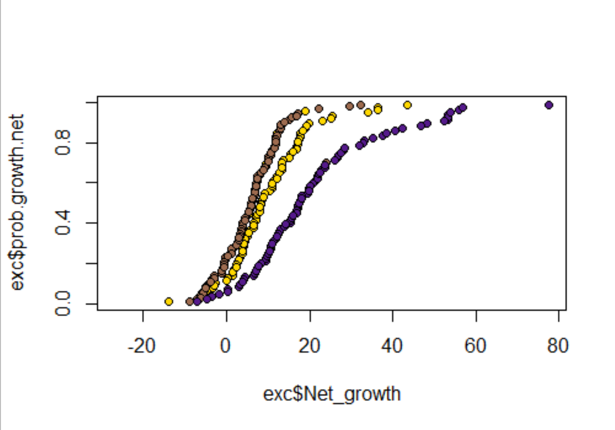
Oysters in low salinity: Net growth was lower in treatments where individuals were exposed to extreme and moderate reductions in TA. It appears that there is a positive relationship with TA, and that potentially both reduction levels were beyond a threshold condition, at which point, individuals are within an equilibrium physiologically with the surrounding corrosive conditions, presenting a similar curve of exceedance. The largest impact on the net effect occurred between week 0 and week 2, where individual incremental growth had a similar pattern to the net growth. This may suggest that organismal performance in response to reductions in TA may become elicited, earlier, with an additional stressor present (simultaneous reduction in S). Further, the effect of S and TA on growth was so strong in the first two weeks, that its effects propagate through to the overall net growth, suggesting that potential rapid pulses of low TA or high TA may propagate into overall net growth rates. Shorter time periods may be a beneficial way to elevate net growth in this case. I think it is also beneficial to note that all of the treatments did have net growth, which may be attributed to a maximal food availability of high protein algal diet.
Total alkalinity level (umol/kg; % change from ambient)
Low (650; -70%)
Probability of exceedance
Mod (1415; -35%)
High (2130; < -5%)
Week 0-5
Week 0-5
Net growth (mm2)

Slide 32
Comparison to ch 2 results for mussels
In mussels…we see that regardless of S, net calc increases with increasing TA… and that effect weakens as you reduce salinity.
In oysters, we see that in LOW S, over the short term (0-2 weeks), that higher TA has a positive effect on shell growth, and that over the entire experiment higher TA resulted in higher net growth.

Slide 33
Comparison thoughts and implications?
Both mussels’ calcification rates responded positively to TA across S
Oysters grown in low S showed a similar relationship, where decreasing TA reduced (both in the short-term incremental growth rate, and net growth)
Their growth declined with declining TA, however, it seems like once past the 35% reduction in TA, they showed similar growth rates in both low TA treatments
Oysters grown in high S instead showed a parabolic response to TA (after 5 weeks of growth), where growth increased in both elevated and severely reduced TA treatments
Initially, individuals did not respond to changes in TA and maintained similar growth rates, however, net growth shows a bimodal increase in growth at increased TA over ambient conc, and in conditions with extremely low TA.

Slide 34
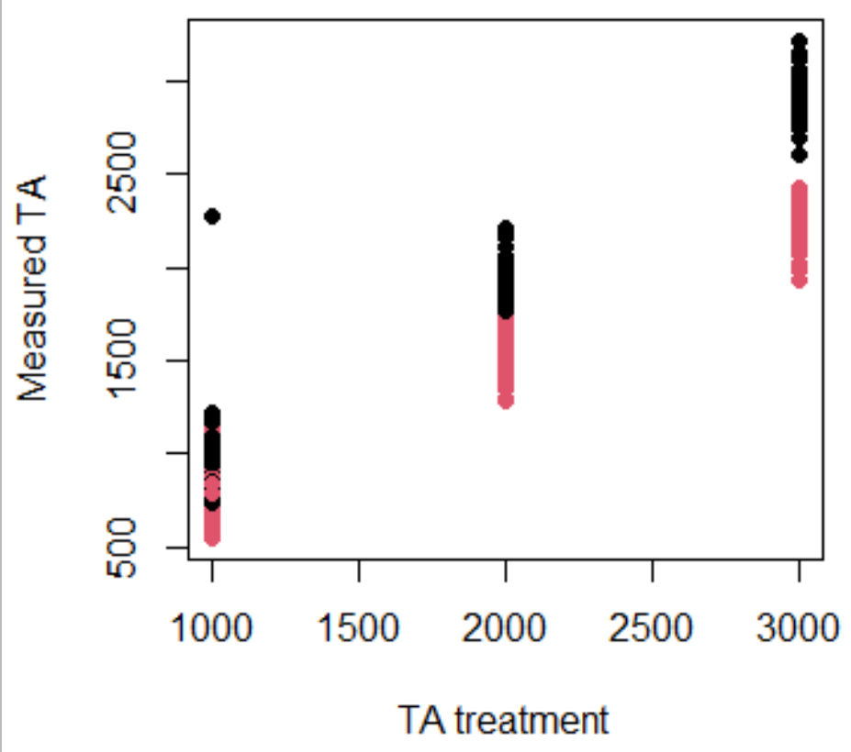
Treatments and sample sizes
Red (low S) and Black (amb S)
Treatments for measured TA vs targets do not necessarily overlap for all bins; if we run the data as a regression does it make more sense to look at each treatment separately?
If we do this, we are not able to compare the effect of S and TA, but are able to demonstrate the effect of TA at both high S and low S
For each of the colors, there are two treatment basins that were used; within each basin, there are between 35-45 individuals (some died/fell off/etc and so have been removed)

Slide 35
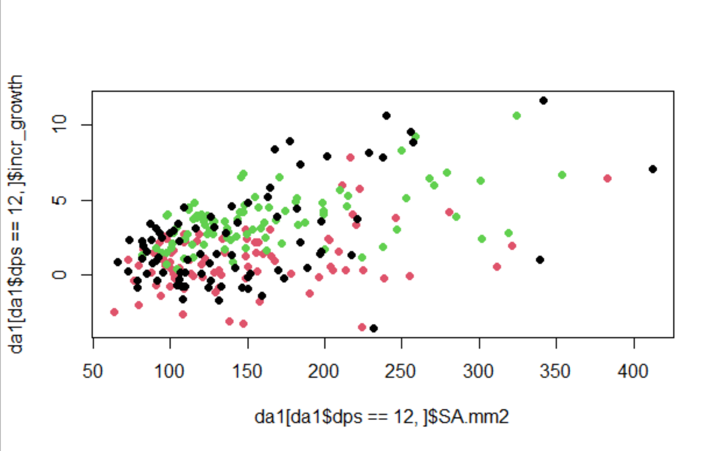
Amb S; 1 - week 2 growth/day
Effect of all drivers.

Slide 36
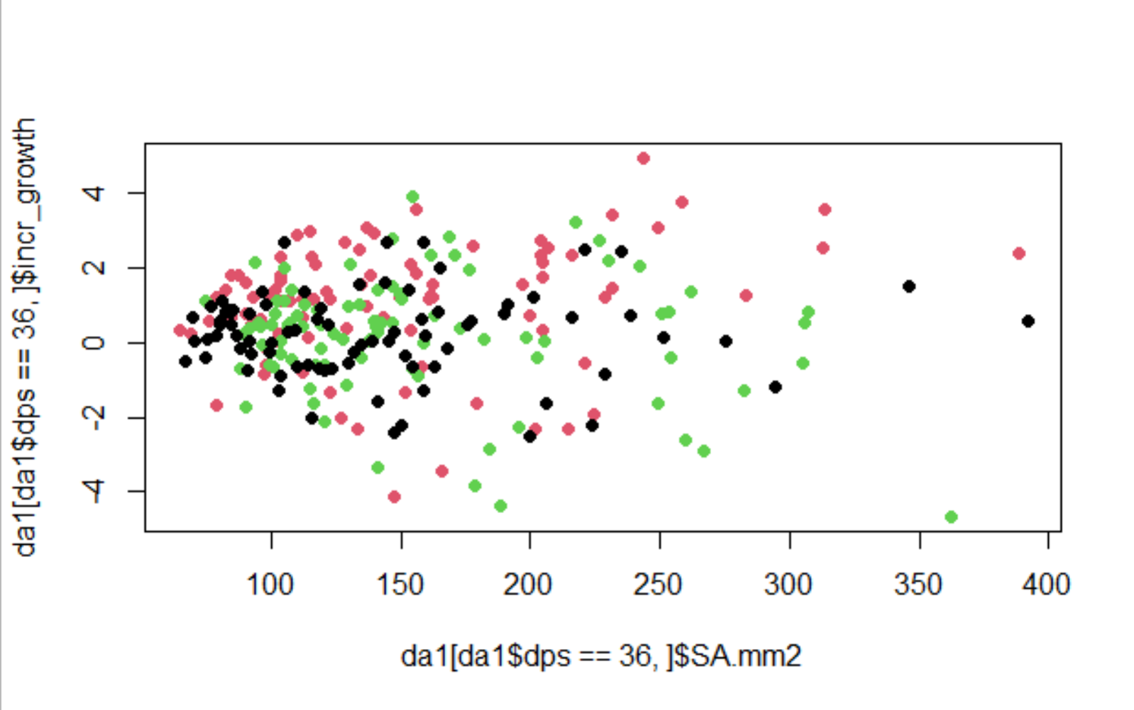
Amb S; 4 - week 5 growth/day
No effect of any drivers.

Slide 37
Amb S; Find the week that the effect disappears
All of the drivers until dps = 36*

Slide 38
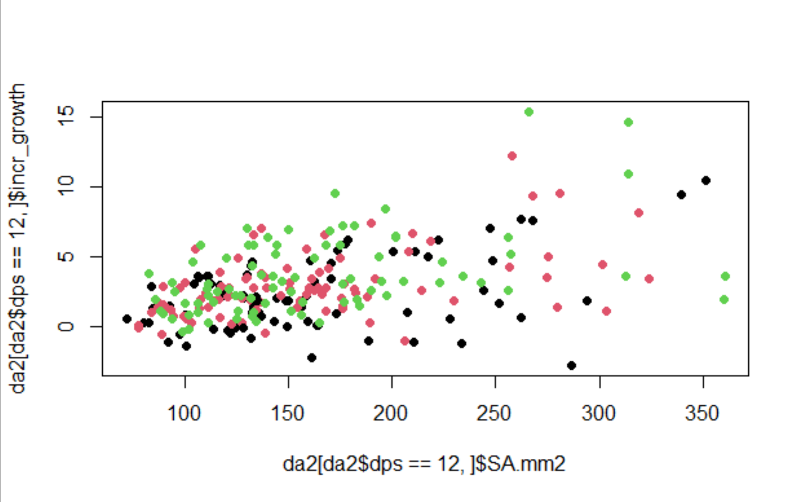
Low S; 1 - week 2 growth/day
Effect of all drivers

Slide 39
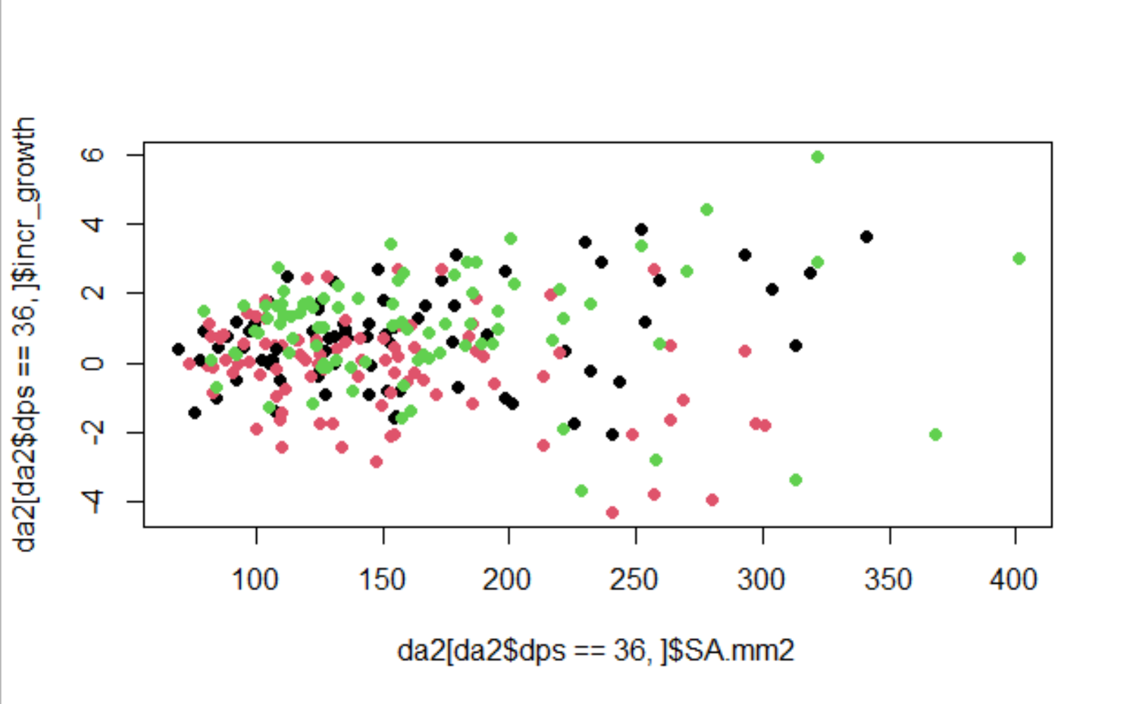
Low S; 4 - week 5 growth/day
No effect of any drivers.

Slide 40
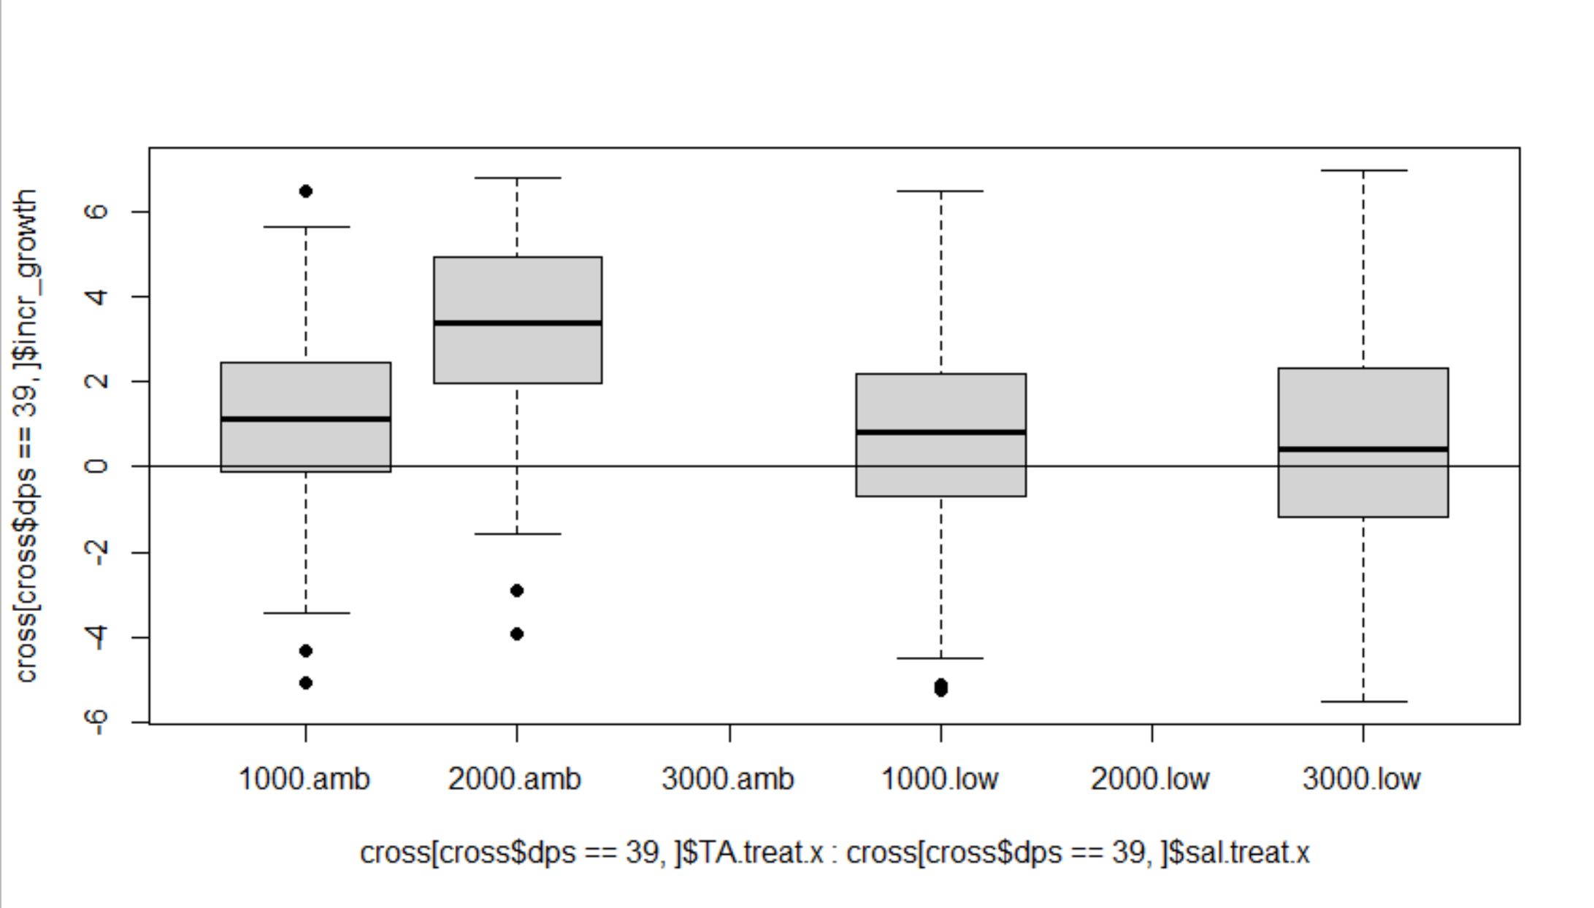
Incremental growth on last day in the cross bins

Slide 41
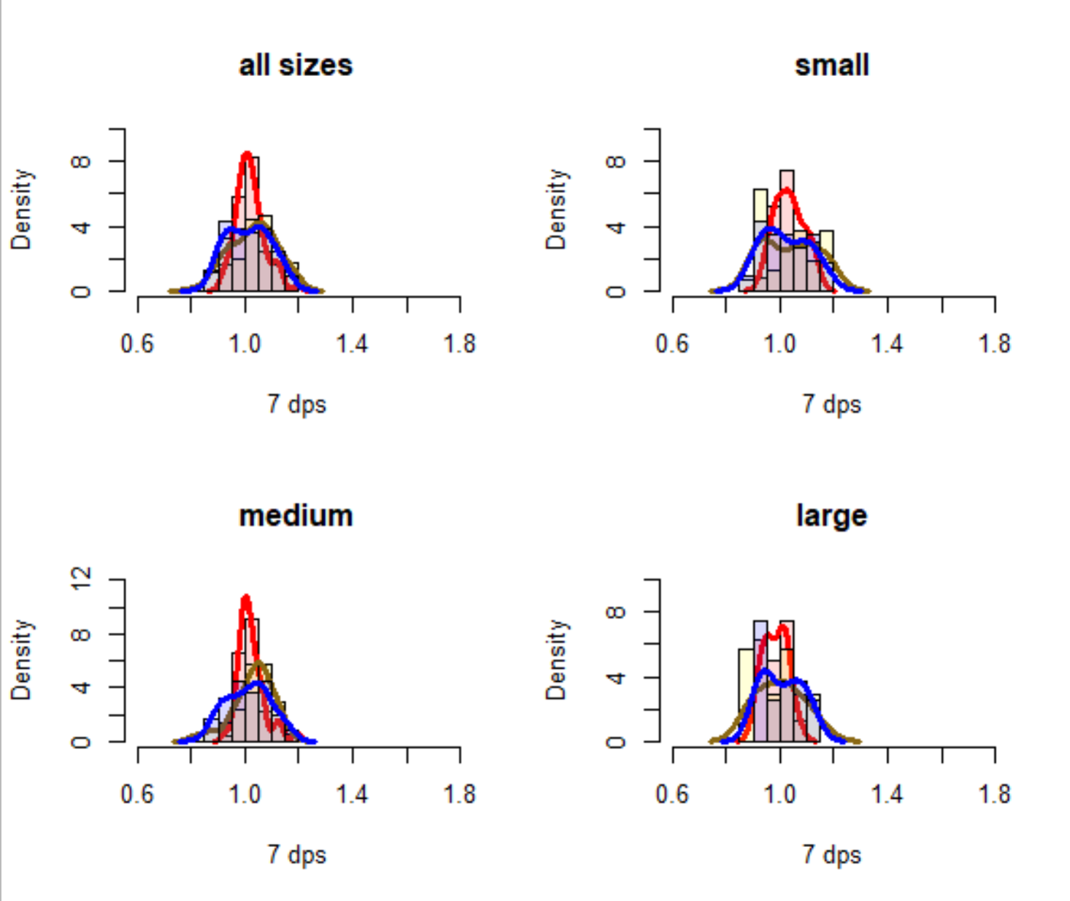
EFFECT OF SIZE AND ALKALINITY ON GROWTH RATIO AFTER 1 WEEK
TA treatment
1000
2000
3000
High salinity

Slide 42
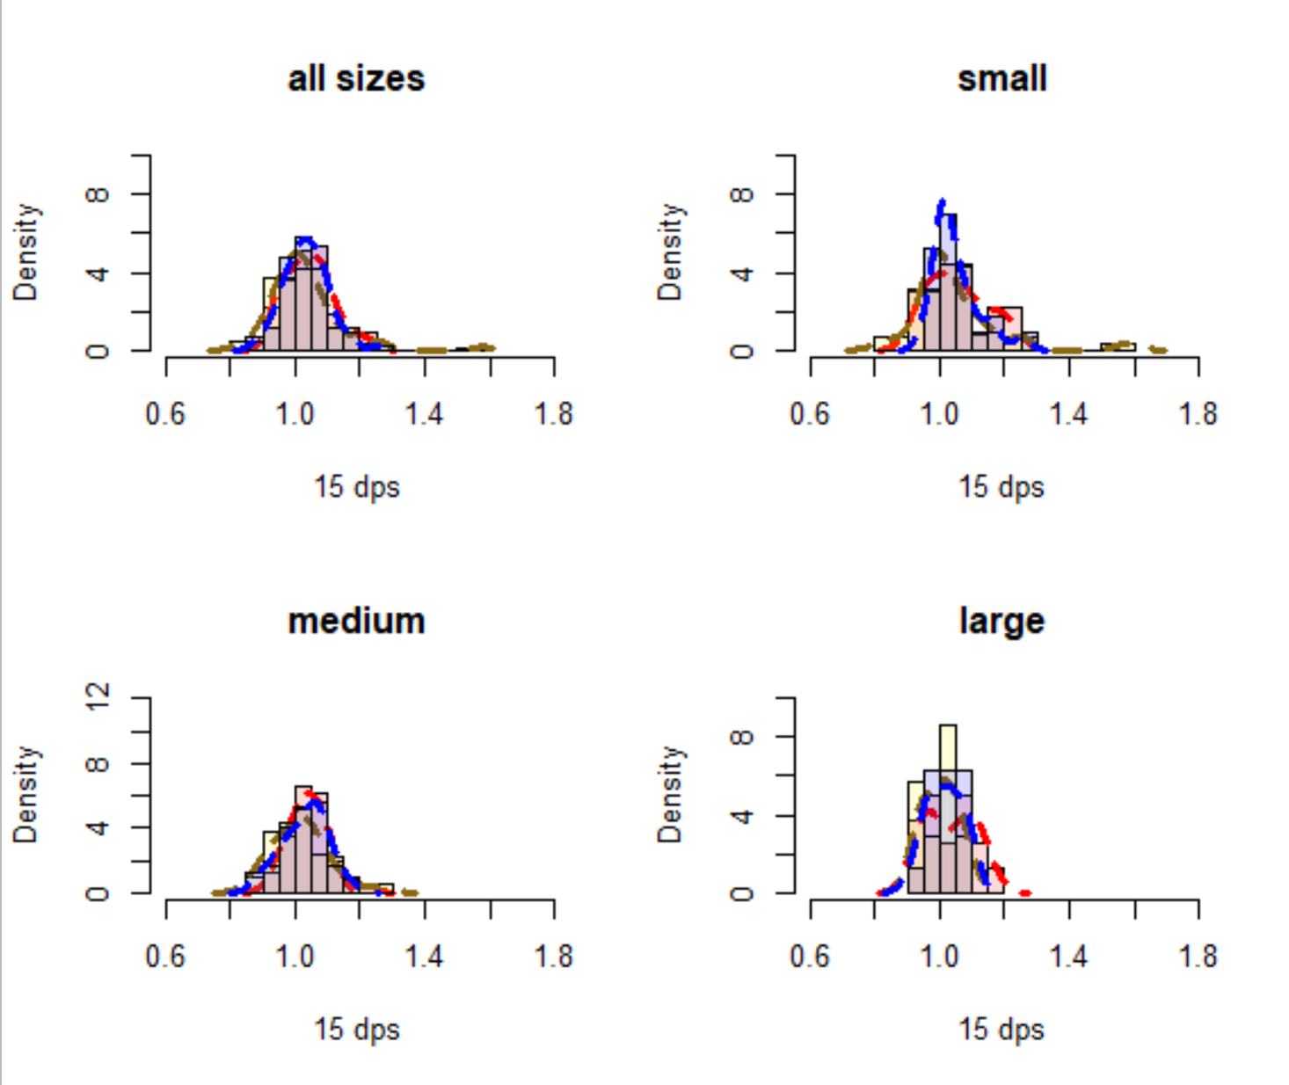
EFFECT OF SIZE AND ALKALINITY ON GROWTH RATIO AFTER 2 WEEKS
TA treatment
1000
2000
3000
High salinity

Slide 43
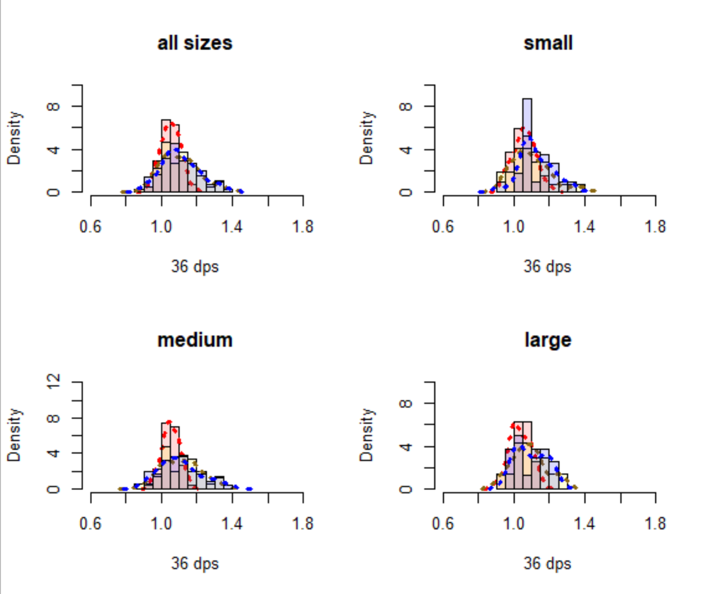
EFFECT OF SIZE AND ALKALINITY ON GROWTH RATIO AFTER 5 WEEKS
TA treatment
1000
2000
3000
High salinity

Slide 44
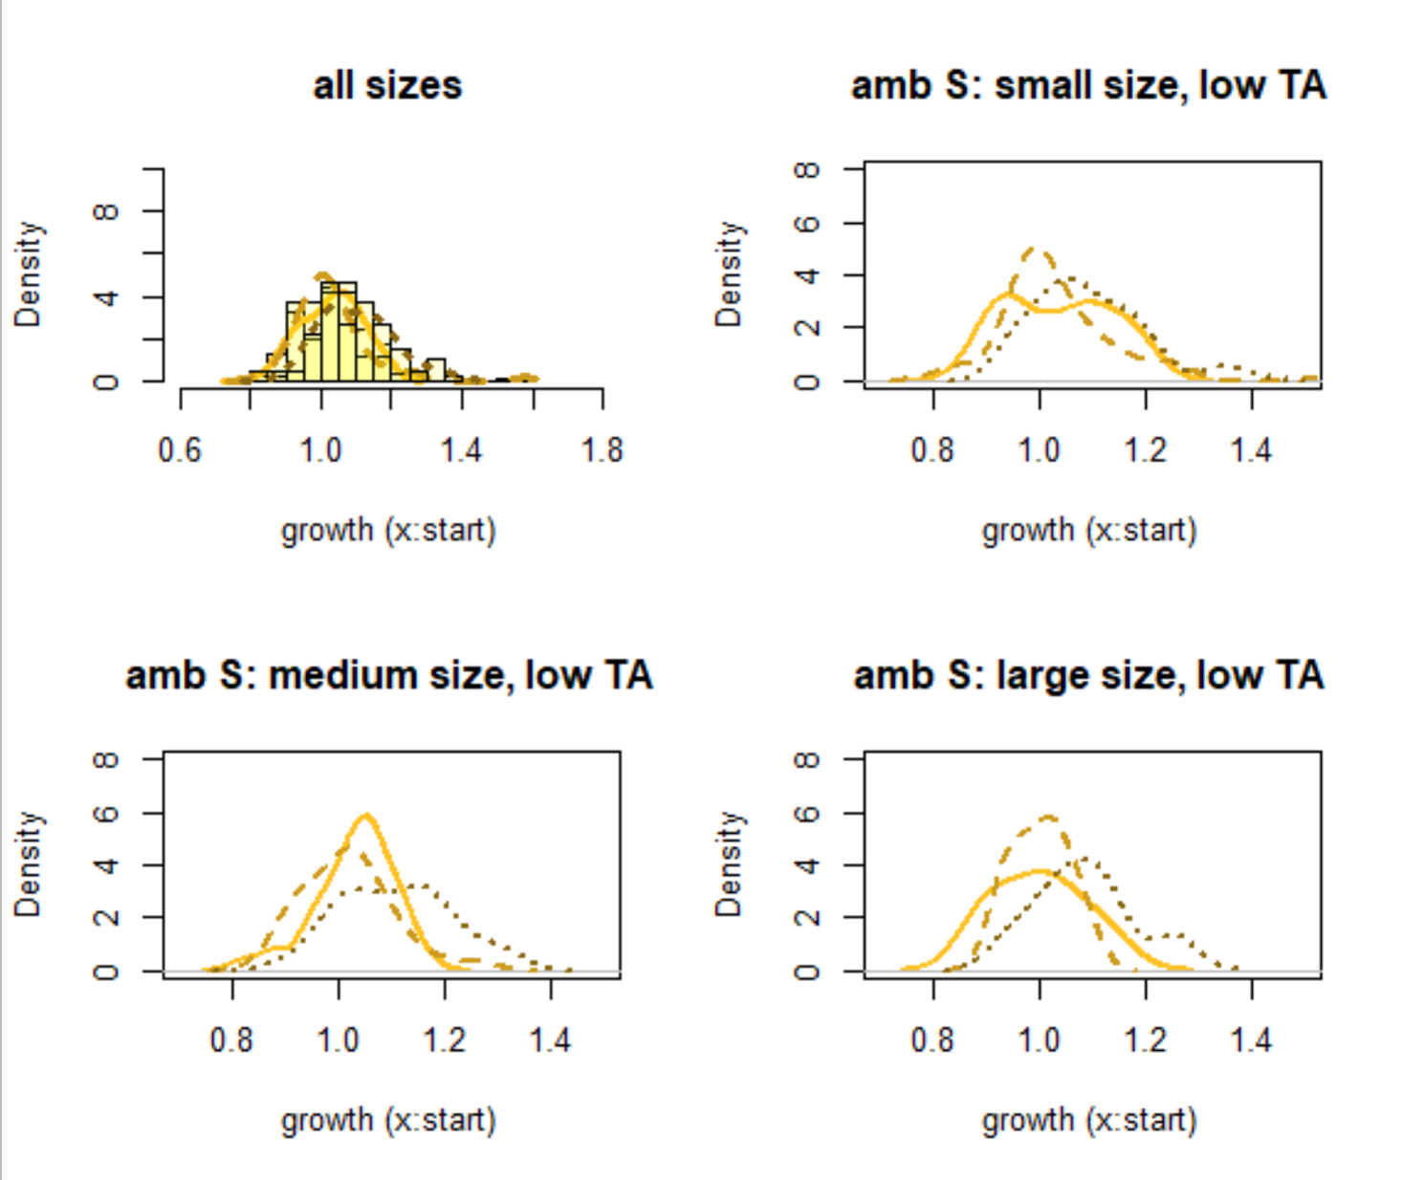
EFFECT OF TIME ON GROWTH RATIO (ACCLIMATION DIFFERENCES) WITHIN EACH TREATMENT/SIZE GROUP
TA treatment
1000
2000
3000
1 week
2 weeks
5 weeks
High salinity
Notes:
maybe slightly bigger in last week
Slow and small acclimation

Slide 45
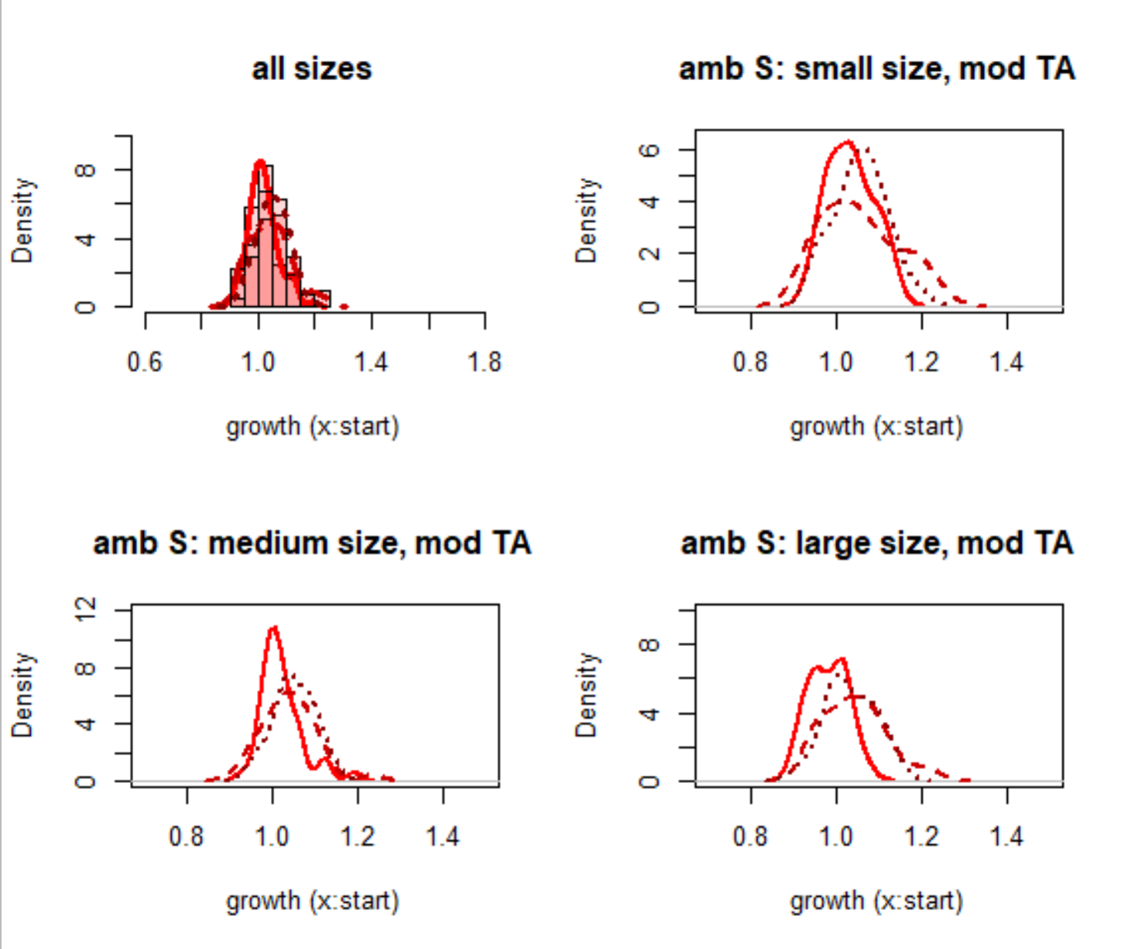
EFFECT OF TIME ON GROWTH RATIO (ACCLIMATION DIFFERENCES) WITHIN EACH TREATMENT/SIZE GROUP
TA treatment
2000
1 week
2 weeks
5 weeks
High salinity
Notes:
Slightly bigger after 2 weeks but no diff to week 3
Fast but minimal acclimation

Slide 46
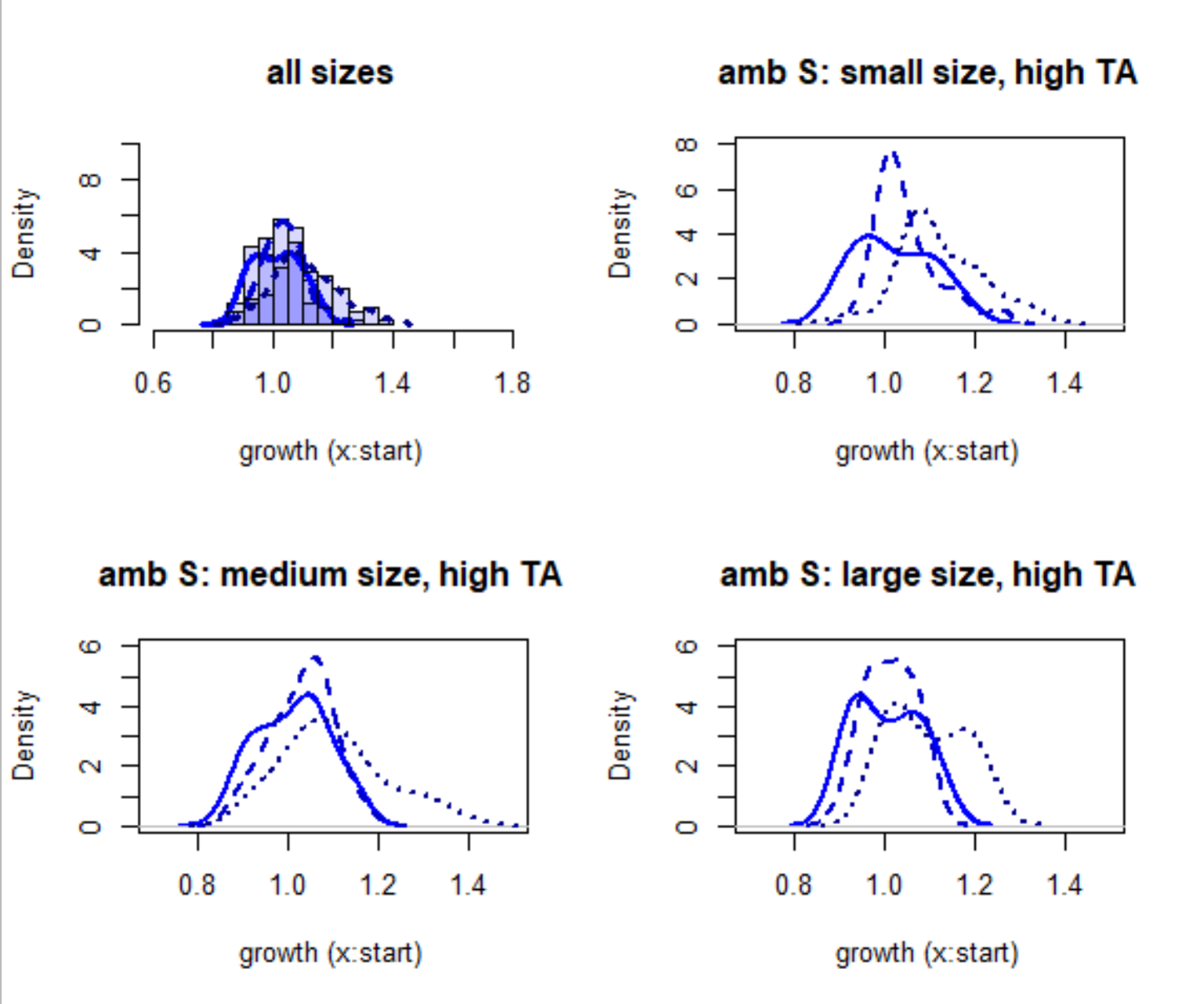
EFFECT OF TIME ON GROWTH RATIO (ACCLIMATION DIFFERENCES) WITHIN EACH TREATMENT/SIZE GROUP
TA treatment
3000
1 week
2 weeks
5 weeks
High salinity
Notes:
Looks like steady increase in r=growth ratio (but maybe mid time doesn’t differ from either?
Slow acclimation; second biggest shifts in growth

Slide 47
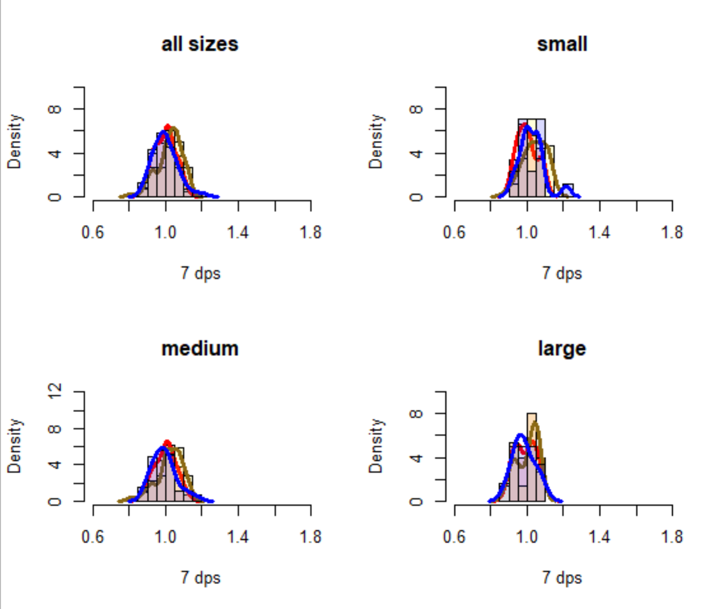
EFFECT OF SIZE AND ALKALINITY ON GROWTH RATIO AFTER 1 WEEK
TA treatment
1000
2000
3000
Low salinity

Slide 48
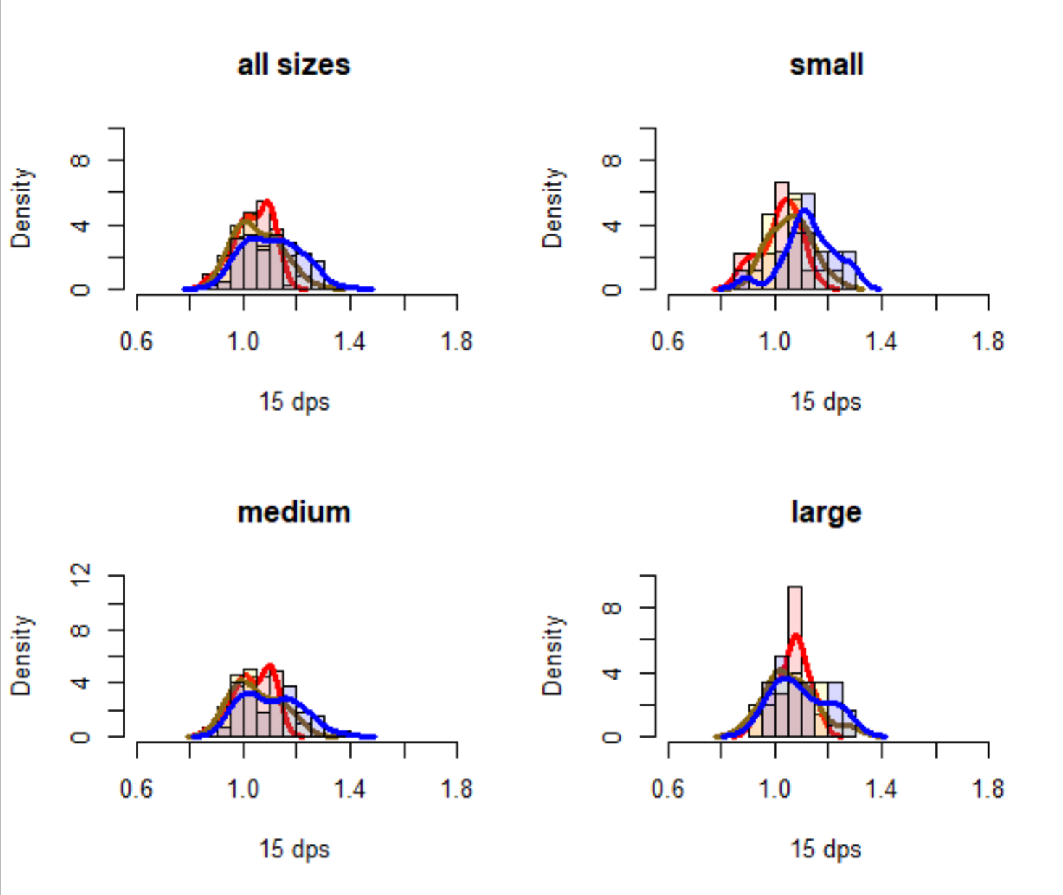
EFFECT OF SIZE AND ALKALINITY ON GROWTH RATIO AFTER 2 WEEKS
TA treatment
1000
2000
3000
Low salinity

Slide 49
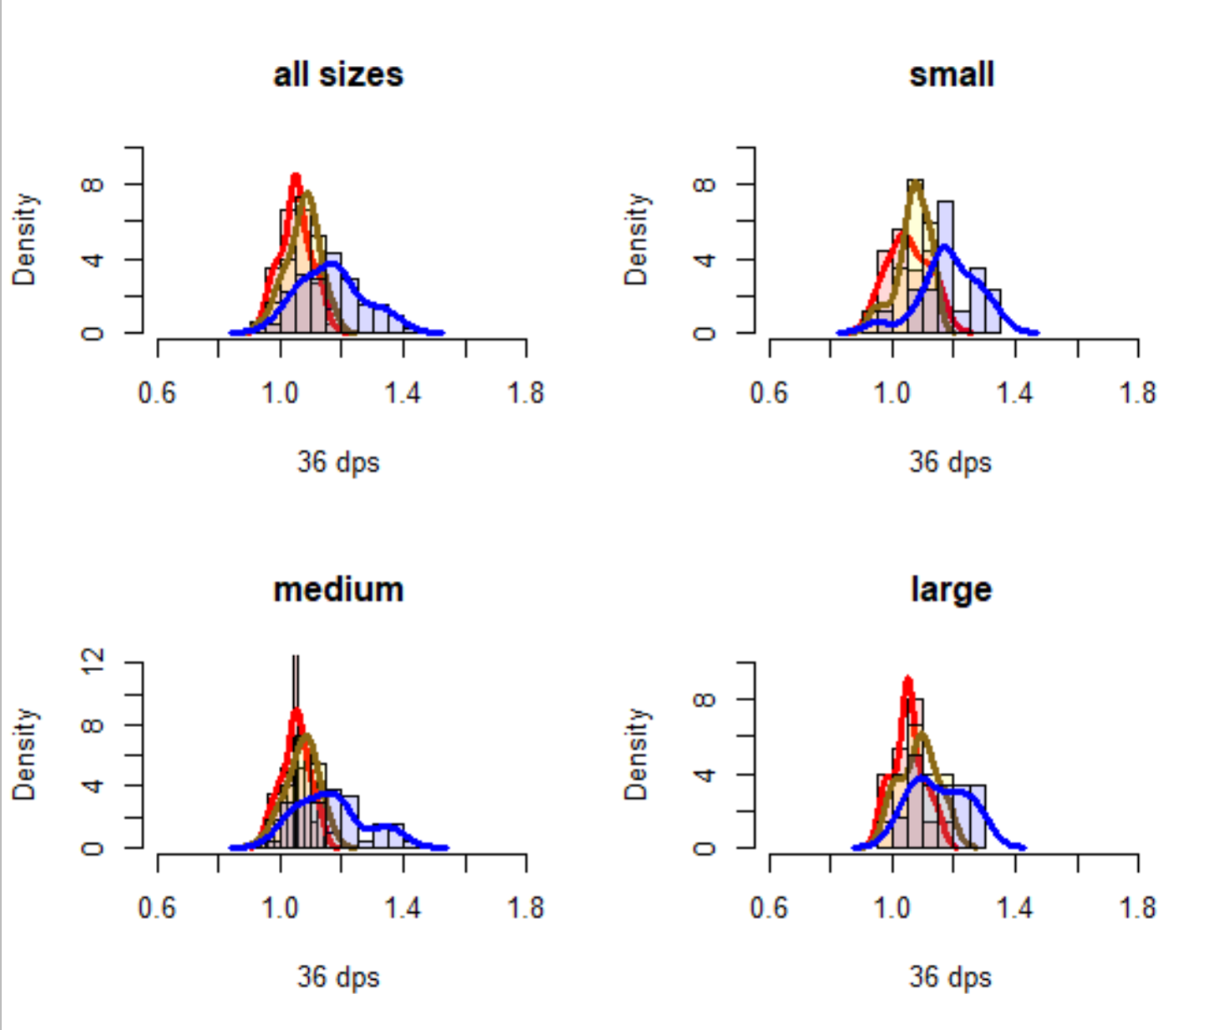
EFFECT OF SIZE AND ALKALINITY ON GROWTH RATIO AFTER 5 WEEKS
TA treatment
1000
2000
3000
Low salinity

Slide 50
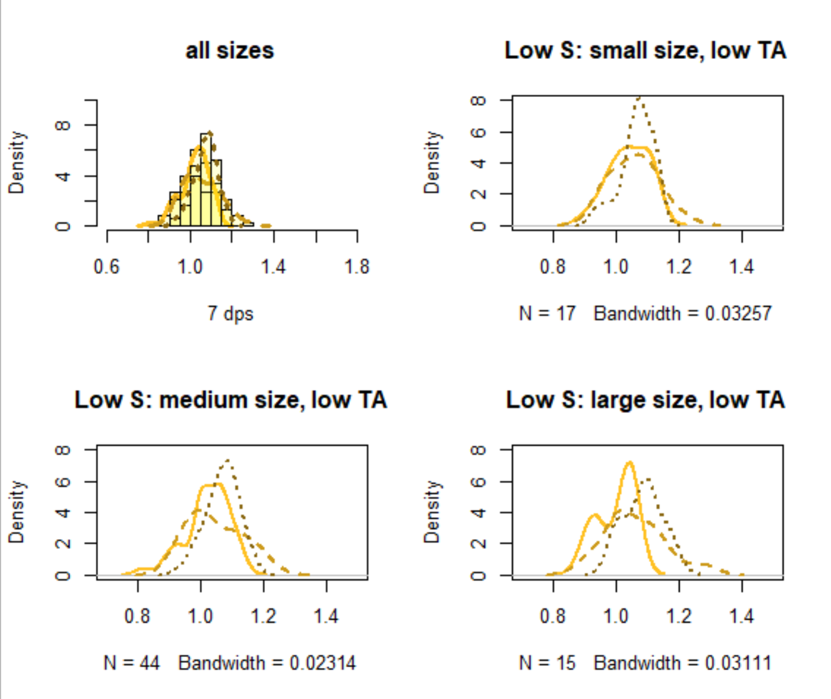
EFFECT OF TIME ON GROWTH RATIO (ACCLIMATION DIFFERENCES) WITHIN EACH TREATMENT/SIZE GROUP
TA treatment
1000
2000
3000
1 week
2 weeks
5 weeks
Low salinity
Notes:
Possible shift to the right on the last week?
Slow acclimation; very small shift

Slide 51
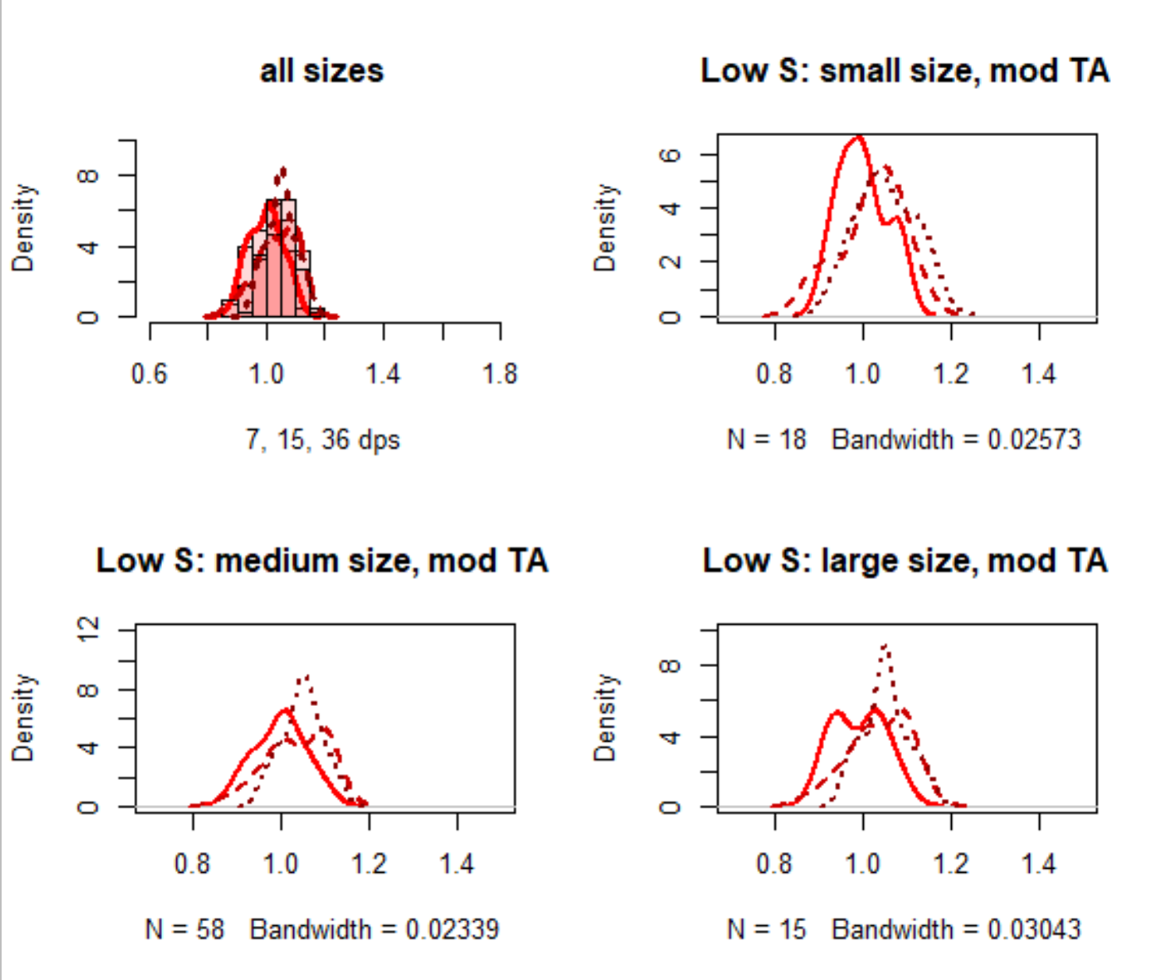
EFFECT OF TIME ON GROWTH RATIO (ACCLIMATION DIFFERENCES) WITHIN EACH TREATMENT/SIZE GROUP
TA treatment
2000
1 week
2 weeks
5 weeks
Low salinity
Notes:
Possible shift to the rig
Fast acclimation (but small)
ht on week 2 but then no difference in week 5 from 2

Slide 52
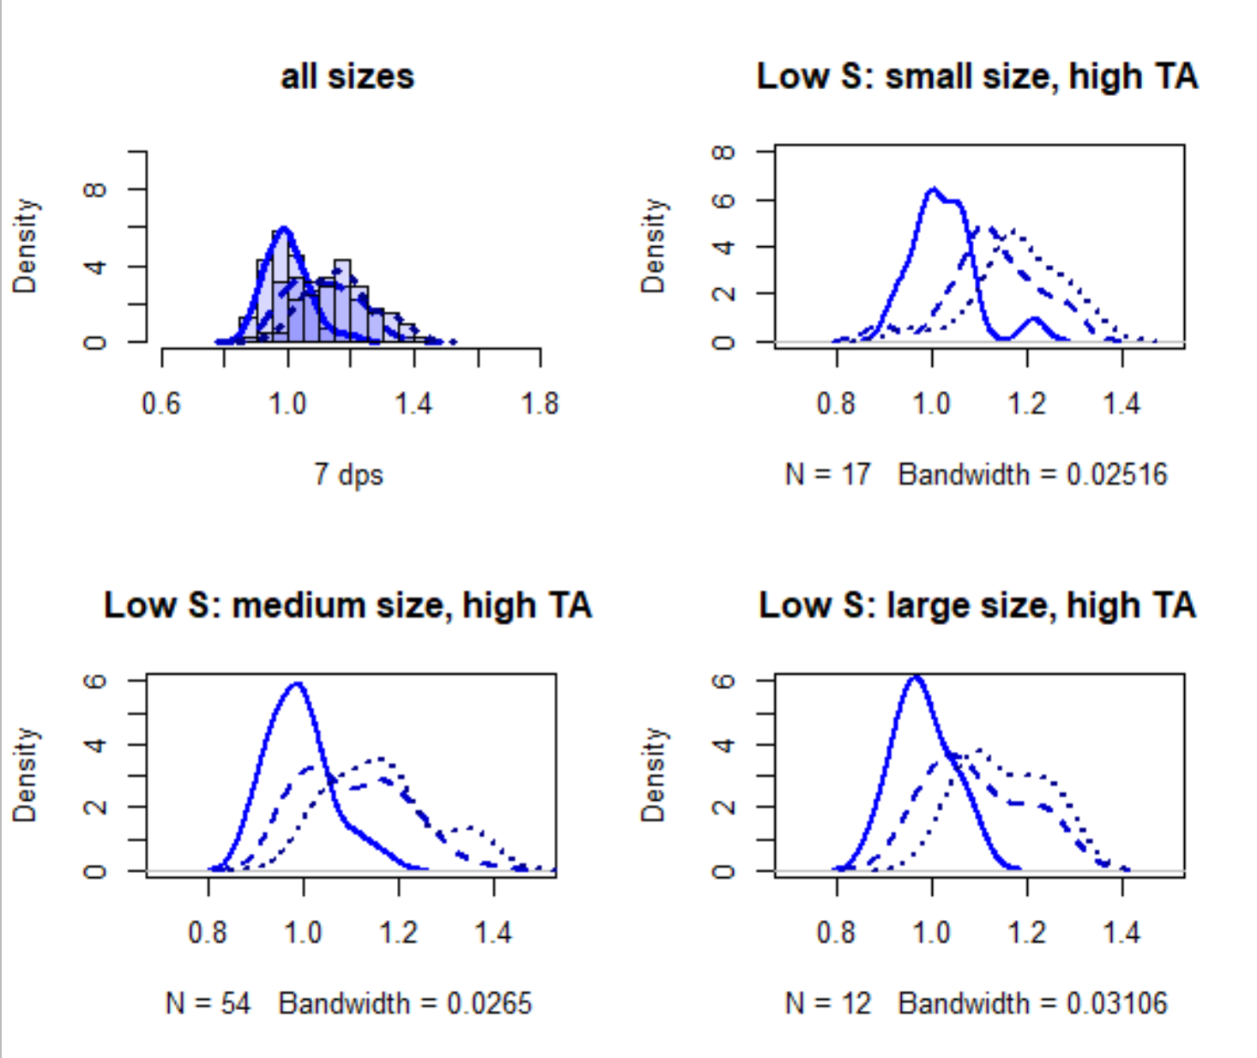
EFFECT OF TIME ON GROWTH RATIO (ACCLIMATION DIFFERENCES) WITHIN EACH TREATMENT/SIZE GROUP
TA treatment
3000
1 week
2 weeks
5 weeks
Low salinity
Notes:
Larger growth rate shift from week 1 to week 2 than in other treatments, almost no change from week 2 to week 5
Fast acclimation

Slide 53
Acclimation Speeds + amounts by treatment
 | Acclimation speed
Degree of growth change? | Fast (change from week 1 to 2, and then no change from week 2 to week 5) | Slow (change from week 1 to 2 and from 2 to 5)
Large shift in average growth ratio | Low S, High TA | High S, High TA
Minimal shift in average growth ratio | High S, Moderate TA Low S, Moderate TA | High S, Low TA Low S, Low TA

Slide 54
Acclimation speed
Big,
slow
Big,
fast
Inc. [TA]
Inc. Salinity
Degree of change
Small, slow
Small, fast

Slide 55
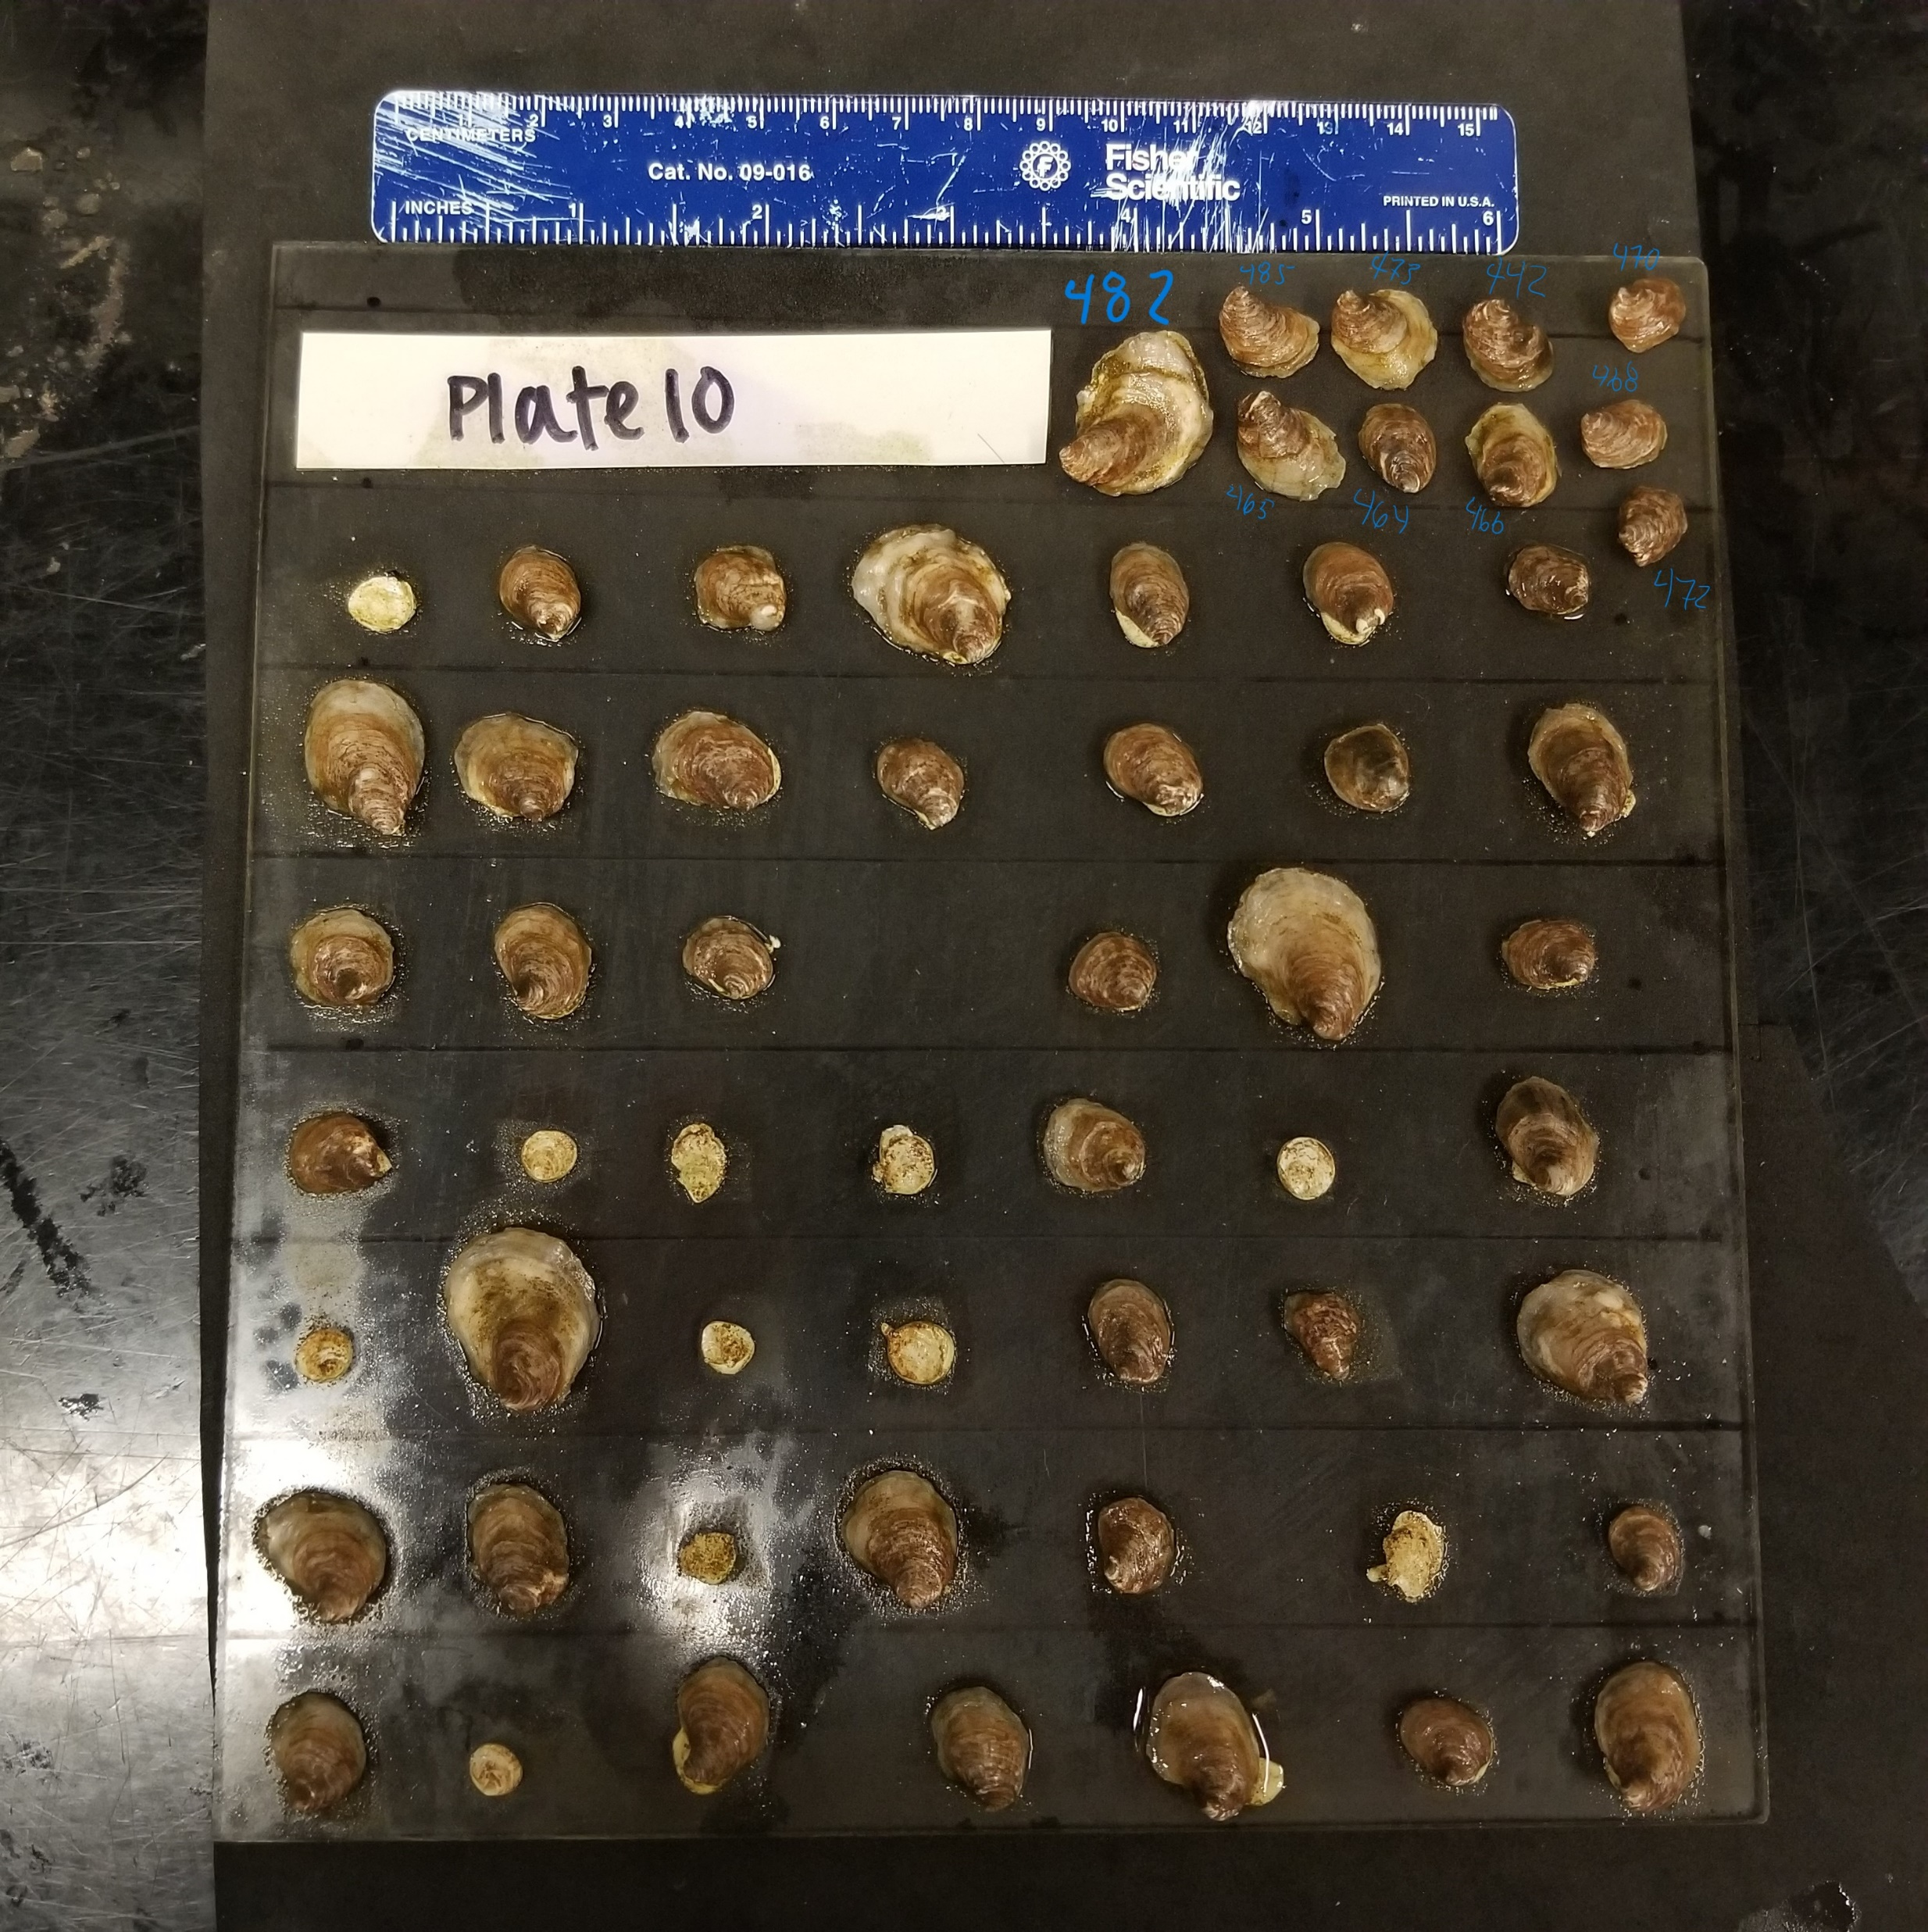
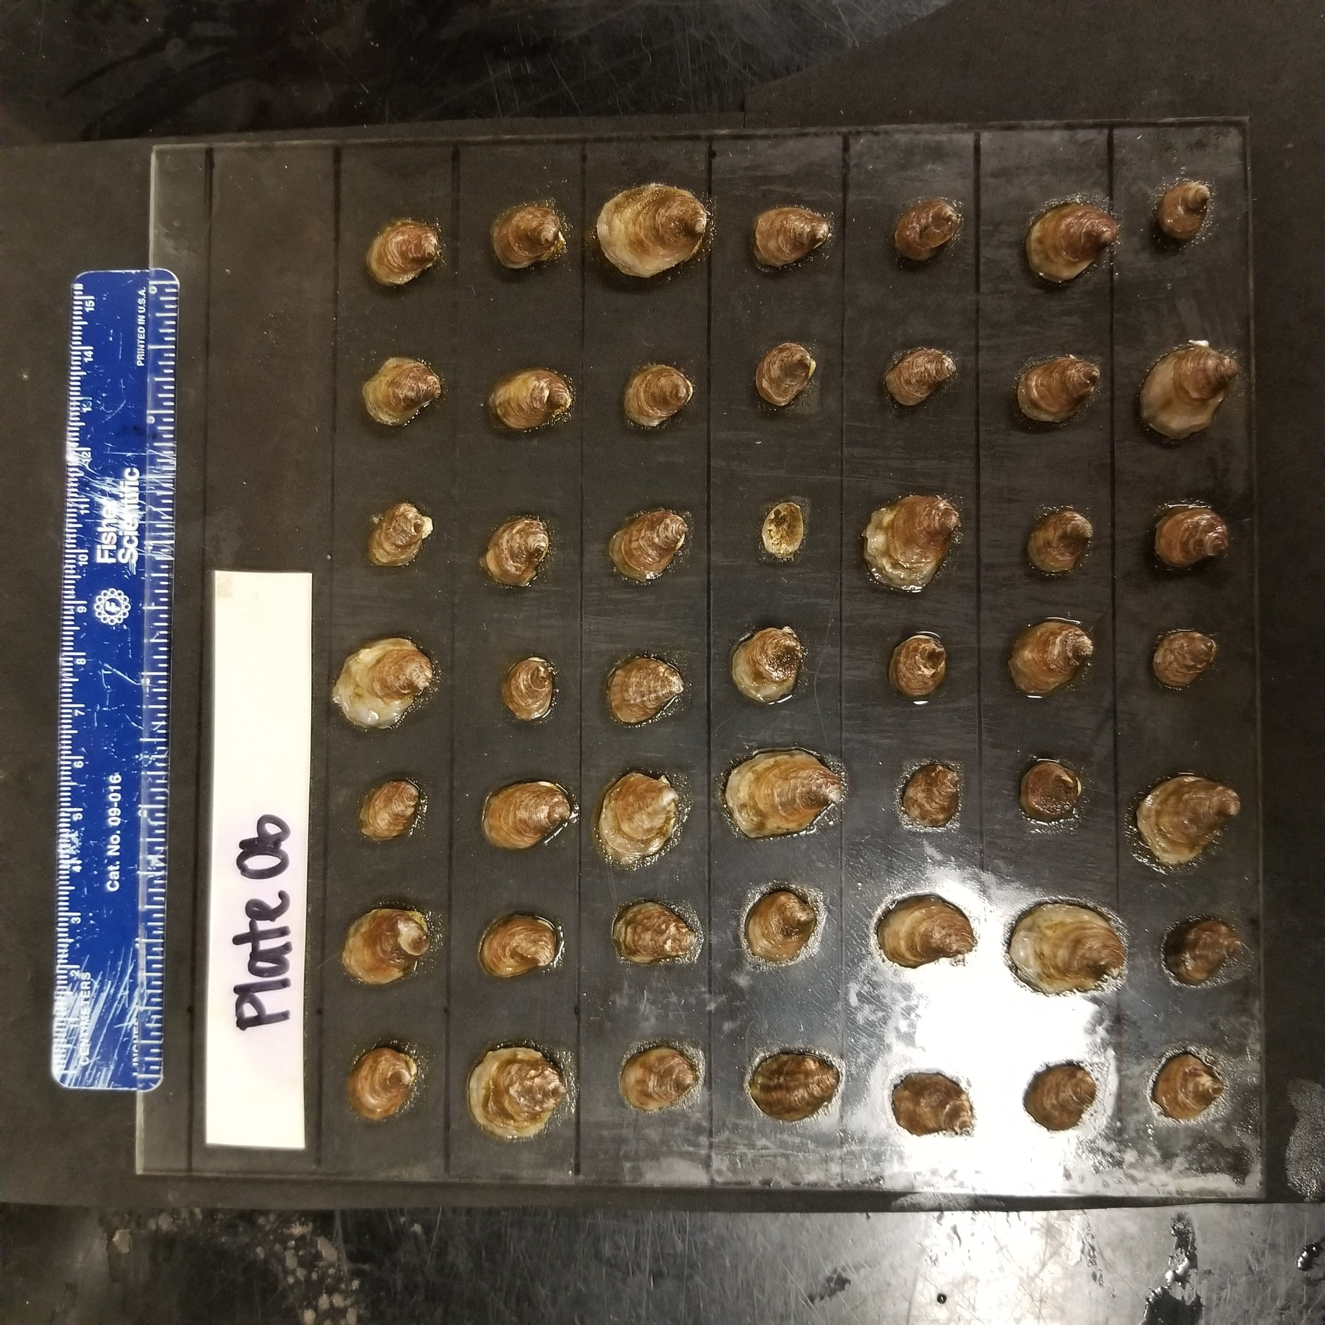
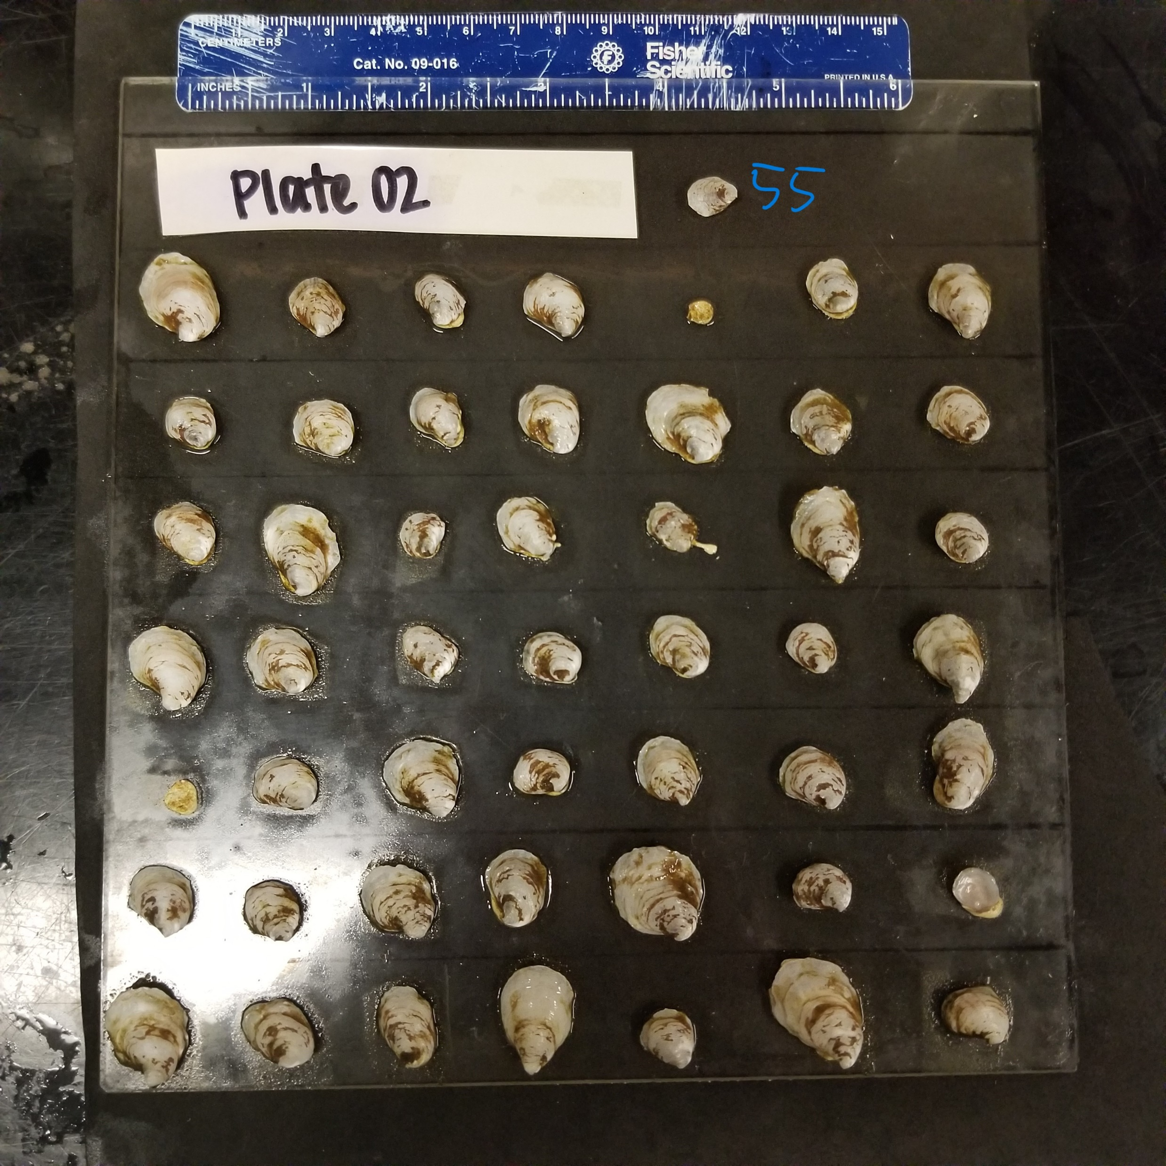
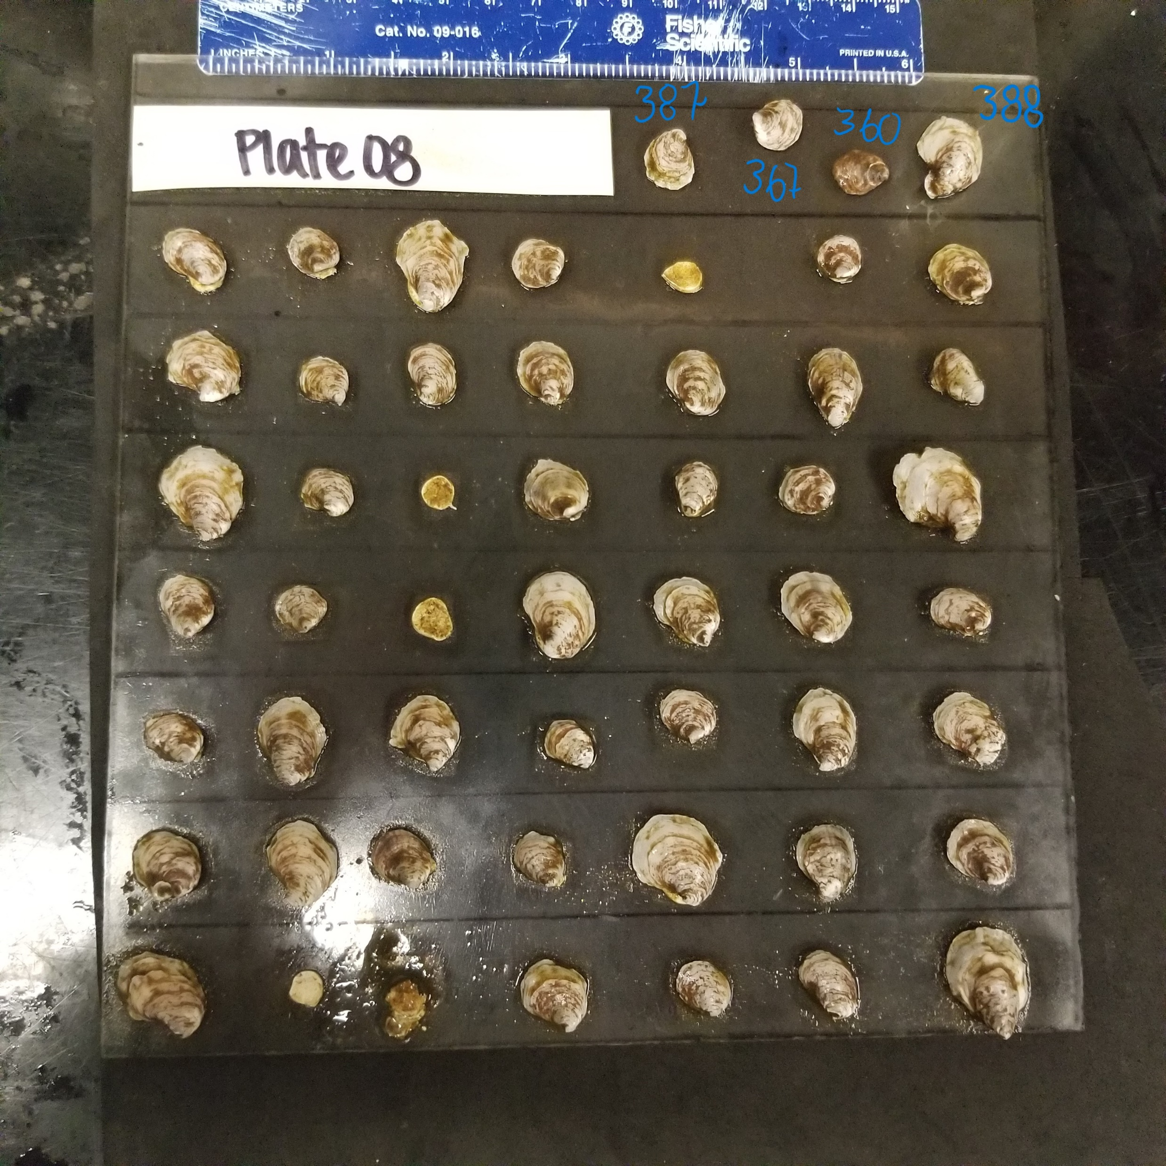
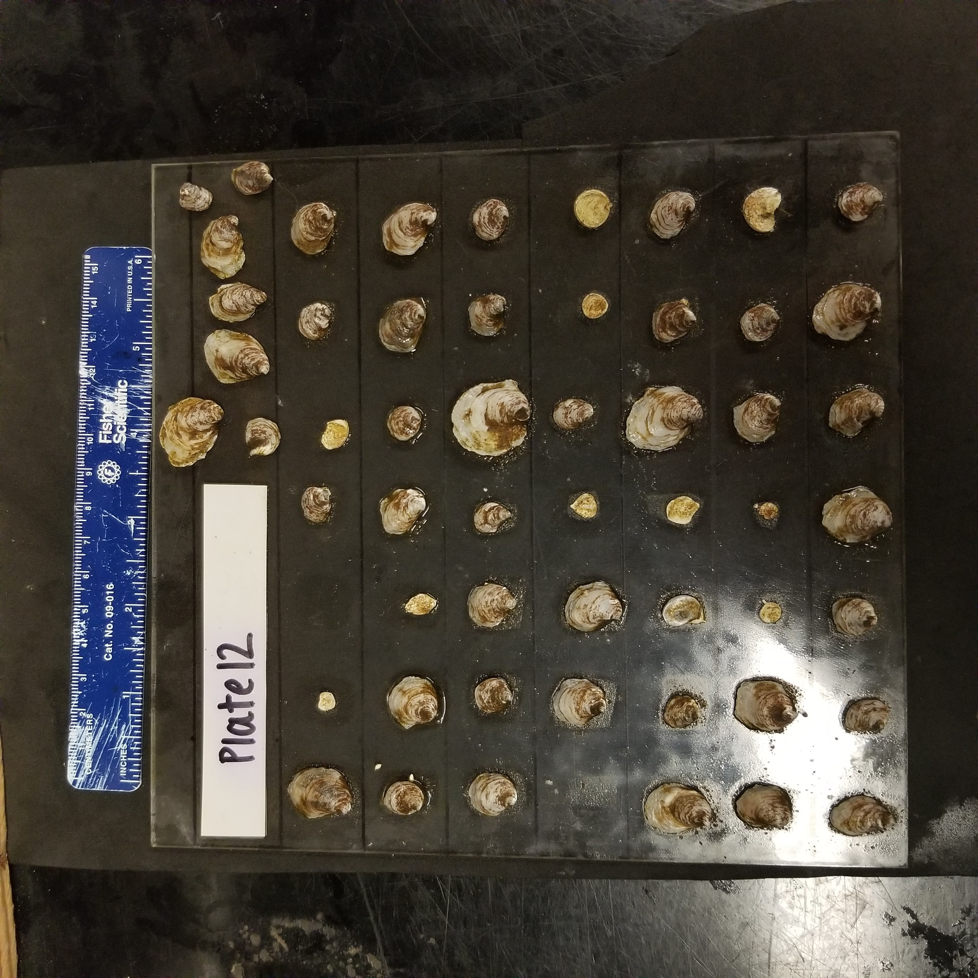
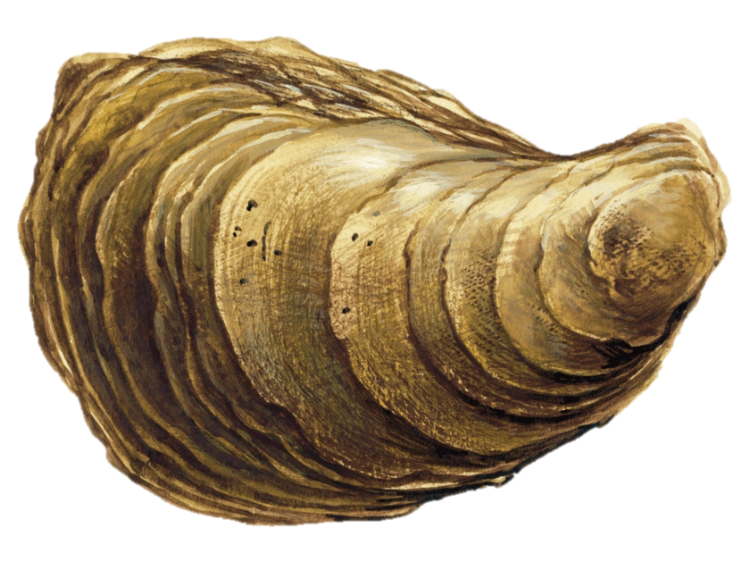
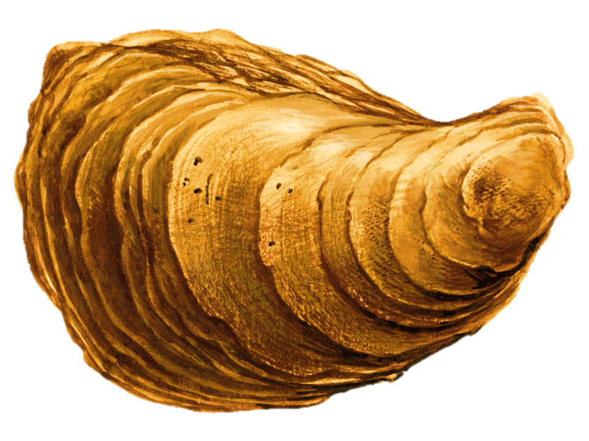
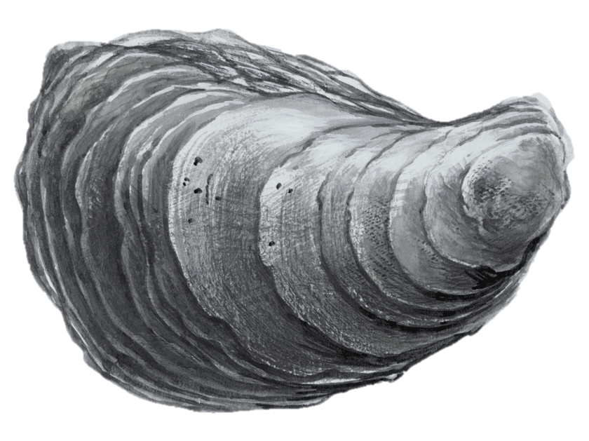
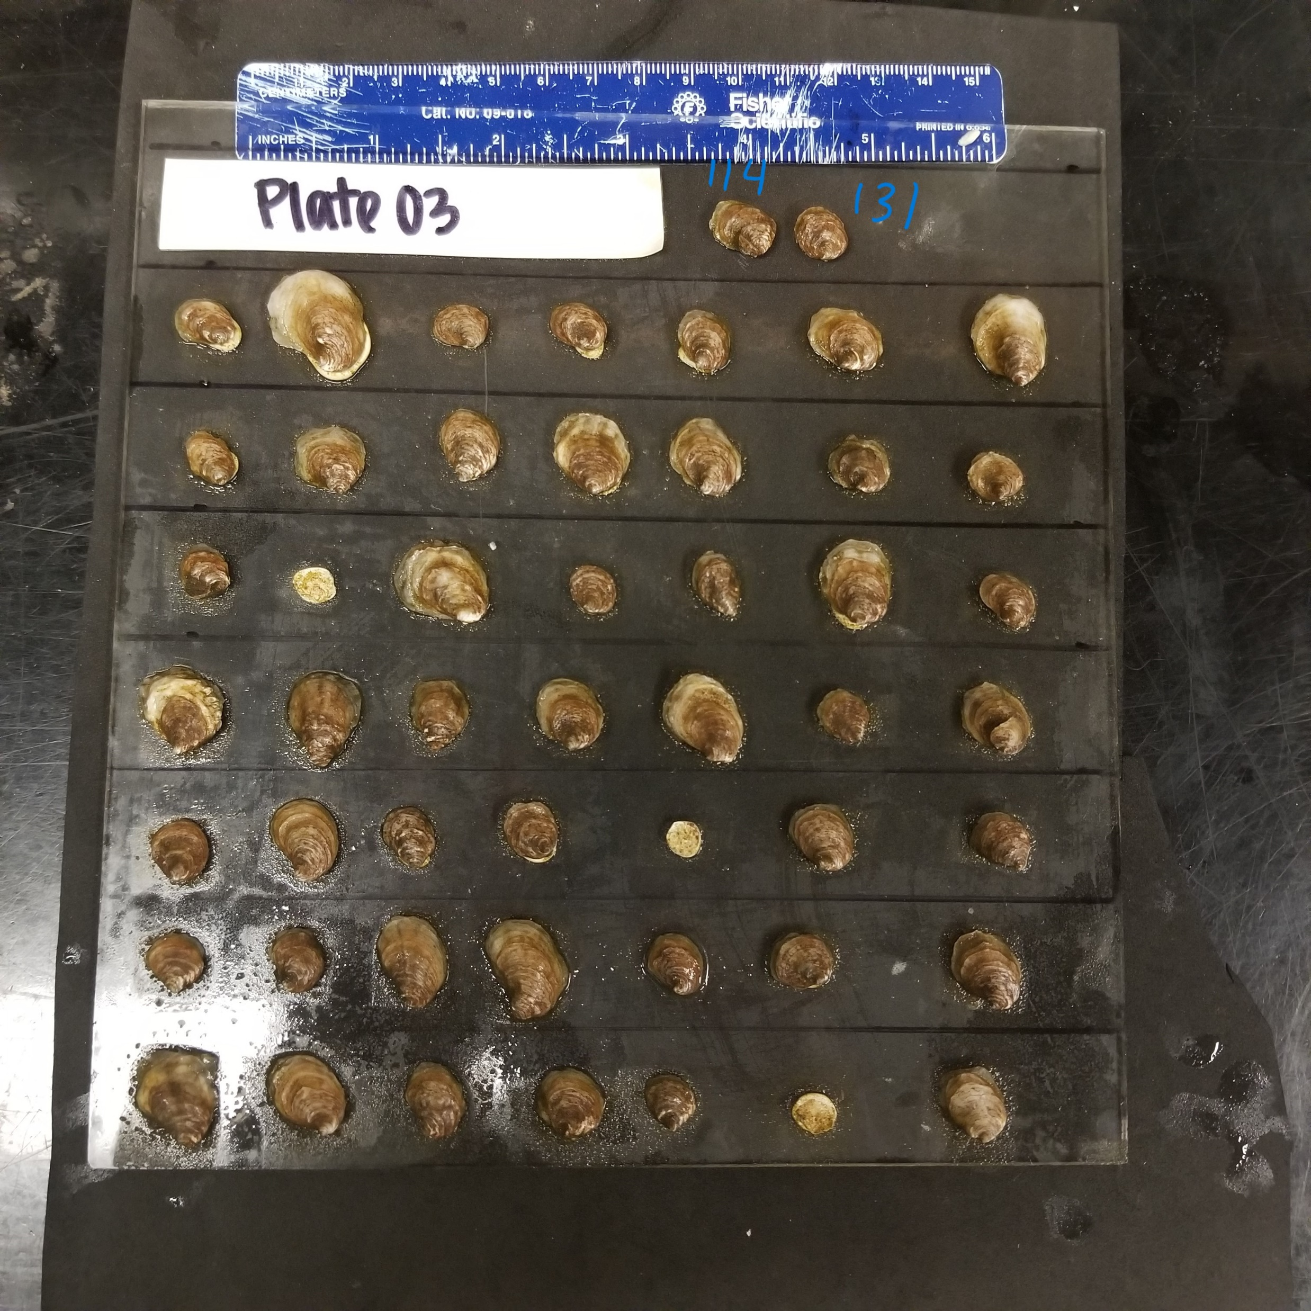
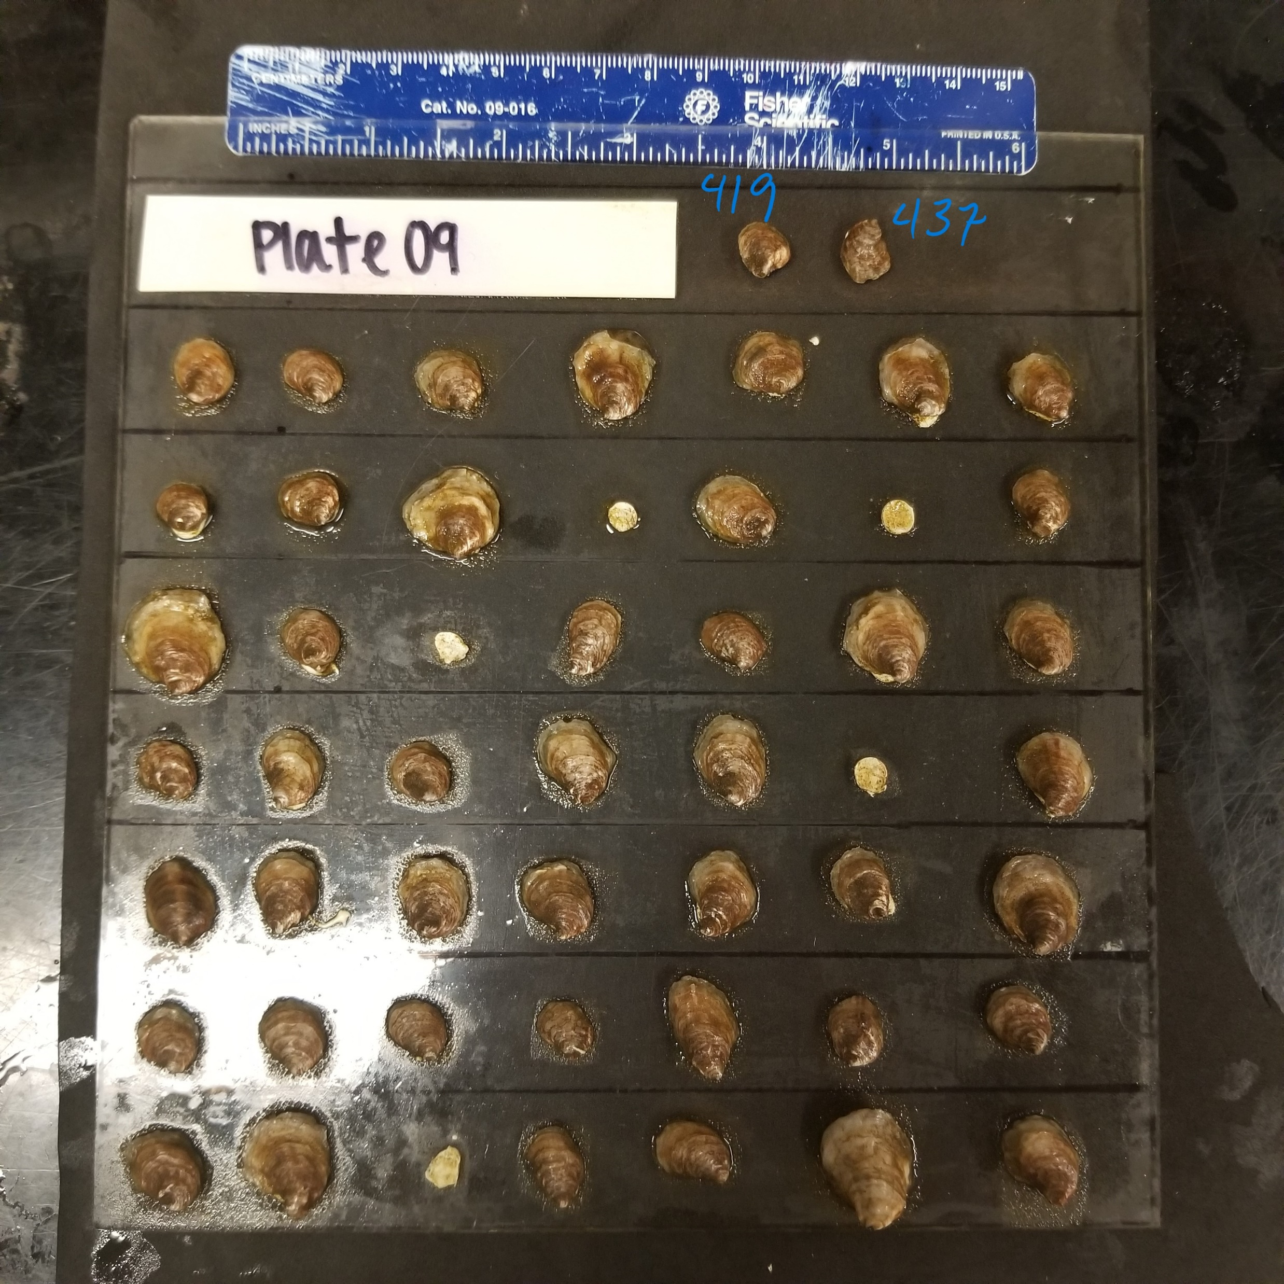






Arrange tiles from white → brown

Slide 56

Color change is related to pH and TA, but not S
6
5
10
9
3
1
Median Total Alkalinity
4
8
12
11
2
7
Low ----------------------------------------> High
relative pH (across a 0.25 unit change)
Notes:
Bottom left: 2 and 7
Bottom middle: 11 (right) and 12 (left)
Middle middle: 4 (left) and 8 (same pH as 10; right)
Middle right: 1 (left) and 3 (right)
Middle top: 9 (right) and 10 (left; same pH as 4 and 8)
Top right: 5 (right) and 6 (left)

Slide 57
Color change is related to pH and TA, but not S
increasing pH improves coloration
increasing TA improves coloration
Median Total Alkalinity
Low ----------------------------------------> High
relative pH (across a 0.25 unit change)

Slide 58
Color change is related to pH and TA, but not S
increasing pH improves coloration
increasing TA improves coloration
Median Total Alkalinity
Low ----------------------------------------> High
relative pH (across a 0.25 unit change)

Slide 59
Color change is related to pH and TA, but not S
increasing pH improves coloration
increasing TA improves coloration
Median Total Alkalinity
Low ----------------------------------------> High
relative pH (across a 0.25 unit change)

Slide 60

Do we see patterns related to organic content?
ab
d
d
ab
d
ab
1 2 3 4 5 6 7 8 9 10 11 12 "ab" "c" "b" "d" "d" "d" "d" "ad" "ab" "ab" "bc" "e"
c
ad
b
d
bc
e

Slide 61

Assigning each group a ‘saturation’ icon
d
ad
e
ab
c
ab
ab
d
d
bc
b
d

Slide 62
Color change is related to pH and TA, but not S
d
d
ab
ab
b
ab
Median Total Alkalinity
ad
d
d
c
bc
e
Low ----------------------------------------> High
relative pH (across a 0.25 unit change)

Slide 63
Color change is related to pH and TA, but not S
d
d
ab
No apparent trend in similarity between the color change and the % organic material
Only comprising between 1-2% of the shell and so may be difficult to see differences in such small changes (based on just perio being removed)
ab
b
Higher % OC
ab
Median Total Alkalinity
ad
d
d
c
bc
e
Low ----------------------------------------> High
relative pH (across a 0.25 unit change)

Slide 64
Color change is related to pH and TA, but not S
d
d
ab
No apparent trend in similarity between the color change and the % organic material
Only comprising between 1-2% of the shell and so may be difficult to see differences in such small changes (based on just perio being removed)
Middle % OC
ab
b
ab
Median Total Alkalinity
ad
d
d
c
bc
e
Low ----------------------------------------> High
relative pH (across a 0.25 unit change)

Slide 65
Color change is related to pH and TA, but not S
d
d
ab
No apparent trend in similarity between the color change and the % organic material
Only comprising between 1-2% of the shell and so may be difficult to see differences in such small changes (based on just perio being removed)
ab
b
ab
Median Total Alkalinity
Low % OC
ad
d
d
c
bc
e
Low ----------------------------------------> High
relative pH (across a 0.25 unit change)

Slide 66
Color change is related to pH and TA, but not S
d
d
ab
No apparent trend in similarity between the color change and the % organic material
Only comprising between 1-2% of the shell and so may be difficult to see differences in such small changes (based on just perio being removed)
Middle % OC
ab
b
Higher % OC
ab
Median Total Alkalinity
Low % OC
ad
d
d
c
bc
e
Low ----------------------------------------> High
relative pH (across a 0.25 unit change)

Slide 67



Shell wt. and SA have very tight relationship; no apparent grouping by TA or S… shell composition is similar

Slide 68

Relationship between size and organic content.. Did not change among different size classes
Larger SA had higher prop of shell as OC matter, makes sense with surface area driven growth
Also suggests that TA nor S strongly dictated the prevalence of a substantial organic layer on shells

Slide 69
Suggesting… the color of the shell, although driven by the presence of periostracum, must also gain color via bacteria/diatom growth
color loss implications for:
1. albedo effect/temperature in low tide?
2. biological layer (vs. organic) between seawater
i. change interaction with biochemical reactions in benthos

Slide 70


Increased TA results in higher SA growth; however, growth rates were higher in low S (not pictured)

Slide 71

Lower condition index resulted in higher OC found in the shell; increasing TA amplified OC at a given CI
Trade off between CI vs OC
“storage” of reserves vs. “shield”?
Higher TA allows for individuals to create more resistant shells?

Slide 72

No relationship between growth and the amount of OC found in the shell
Overall growth didn’t relate to shell composition…so the surface area of the individual wasn’t related to the composition

Slide 73

Shell mass to SA relationship was not impacted by TA or S by the last day of acclimation
Consistent with expectations
Maybe because shells were still small and OC proportion was low relative to the rest of the mass?

Slide 74

Colors by treatment: red = mid TA green = low TA blue = high TA size: ALL

Slide 75

Colors by treatment: red = mid TA green = low TA blue = high TA size: SMALL

Slide 76

Colors by treatment: red = mid TA green = low TA blue = high TA size: MEDIUM

Slide 77

Colors by treatment: red = mid TA green = low TA blue = high TA size: LARGE

Slide 78

Colors by treatment: red = amb S
Green = low S size: all sizes

Slide 79

Colors by treatment: red = amb S
Green = low S size: SMALL

Slide 80

Colors by treatment: red = amb S
Green = low S size: MEDIUM

Slide 81

Colors by treatment: red = amb S
Green = low S size: LARGE

Slide 82

Only high S data, all sizes pooled Colors by treatment: red = mid TA green = low TA blue = high TA

Slide 83

Only low S data, all sizes pooled Colors by treatment: red = mid TA green = low TA blue = high TA

Slide 84


High Salinity
36 days (dark)
15 days (light)
Low Salinity

Slide 85



High Salinity
36 days (dark)
15 days (light)
Low Salinity
3000
2000
1000
3000
2000
1000
3000
2000
1000

Slide 86


36 days (dark)
15 days (light)
High Salinity
Low Salinity
3000
2000
1000

